Slide 1
An Introduction to the Multichannel Rendezvous Problem-Part VII
Prof. Cheng-Shang Chang (張正尚教授)
Institute of Communications Engineering National Tsing Hua University
July 2025

Slide 2
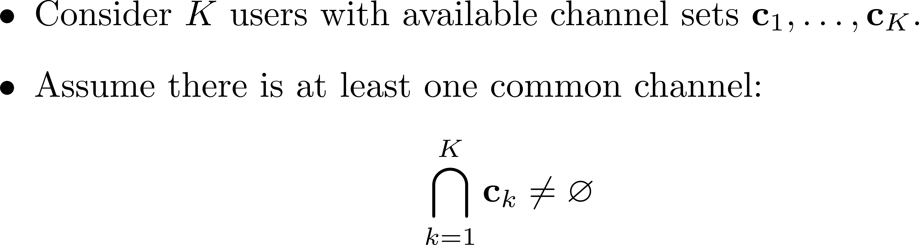
Multichannel rendezvous problem with multiple users
Consistent channel hopping algorithms

Slide 3
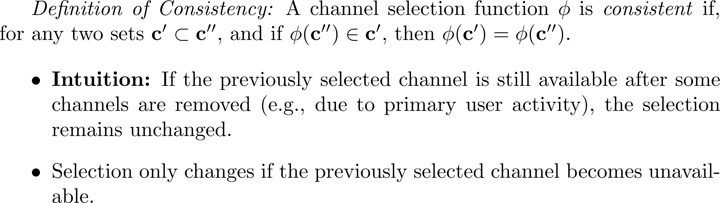









Consistent channel selection functions (CCSF)
$1$
$7$
$2$
$6$
$φ\left( \right)=4$
$=φ\left( \right)$
$$5$$
$4$
$3$

Slide 4
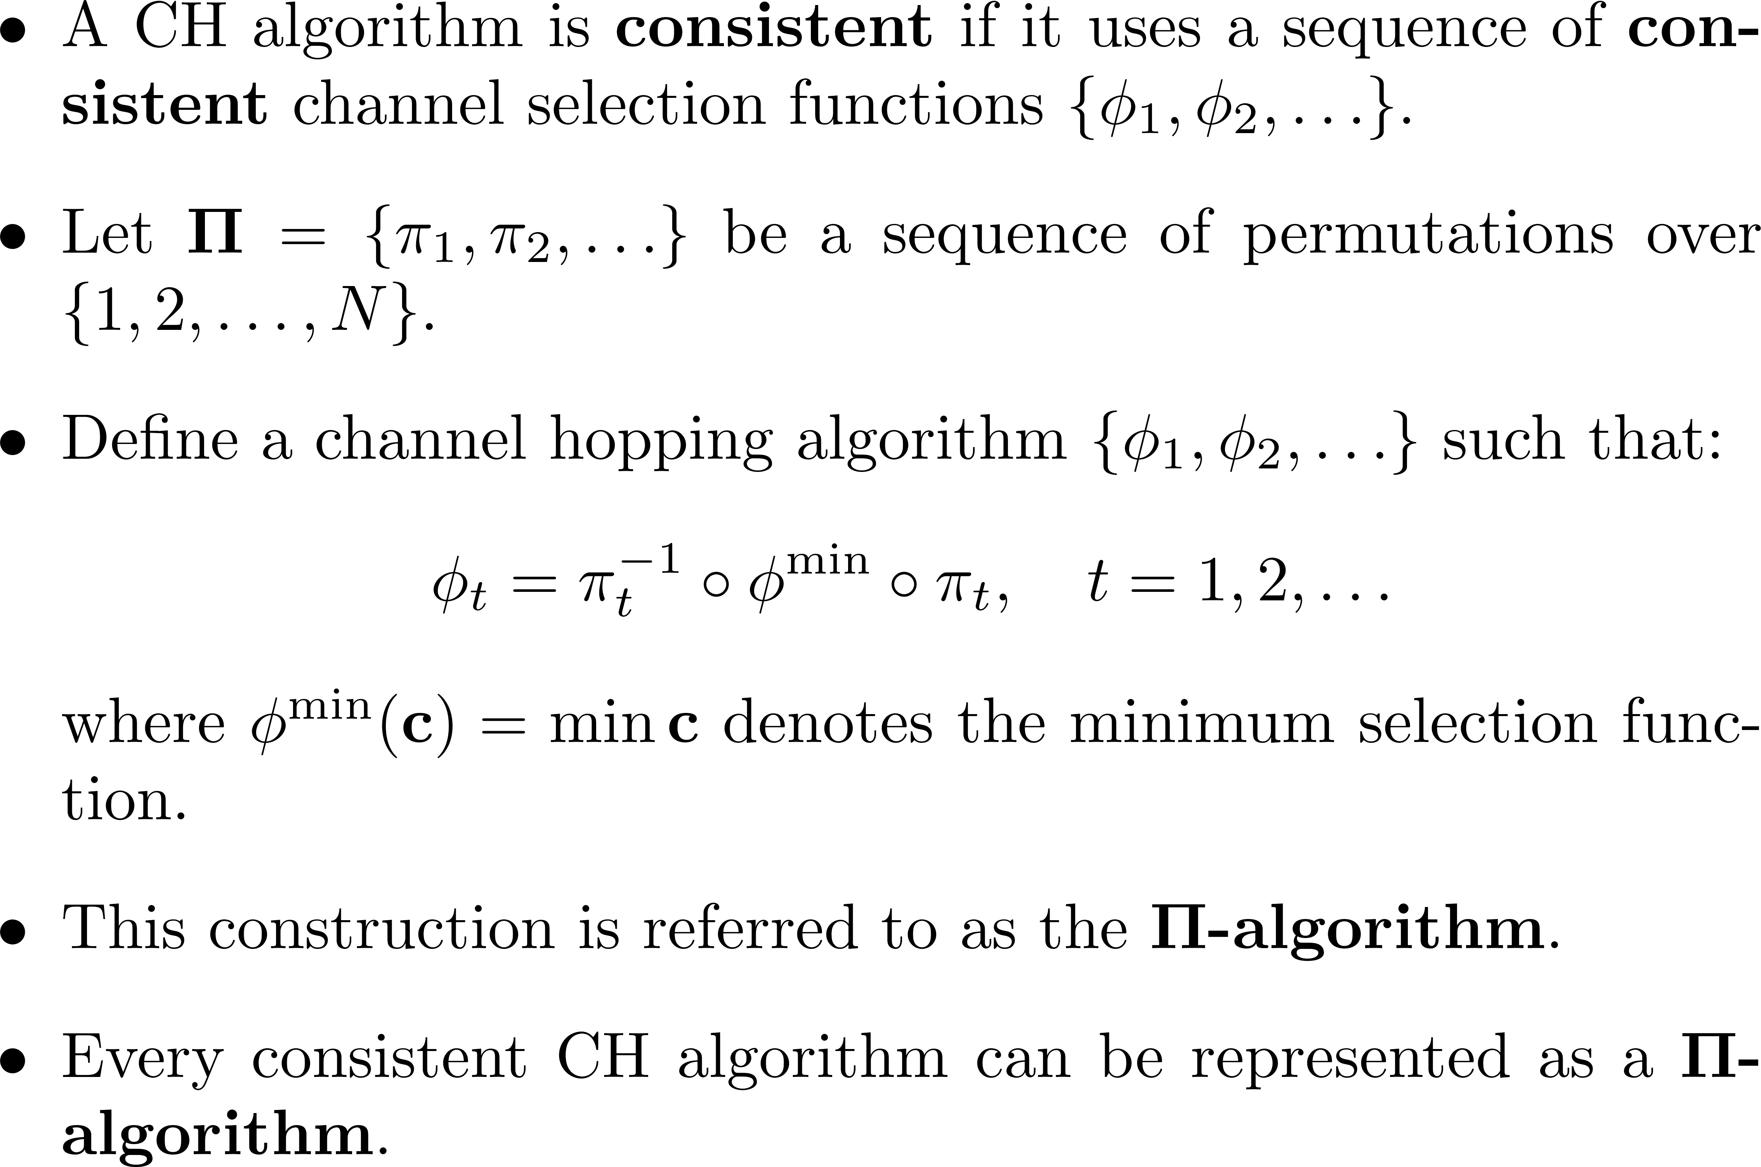
Consistent channel hopping algorithm
4

Slide 5
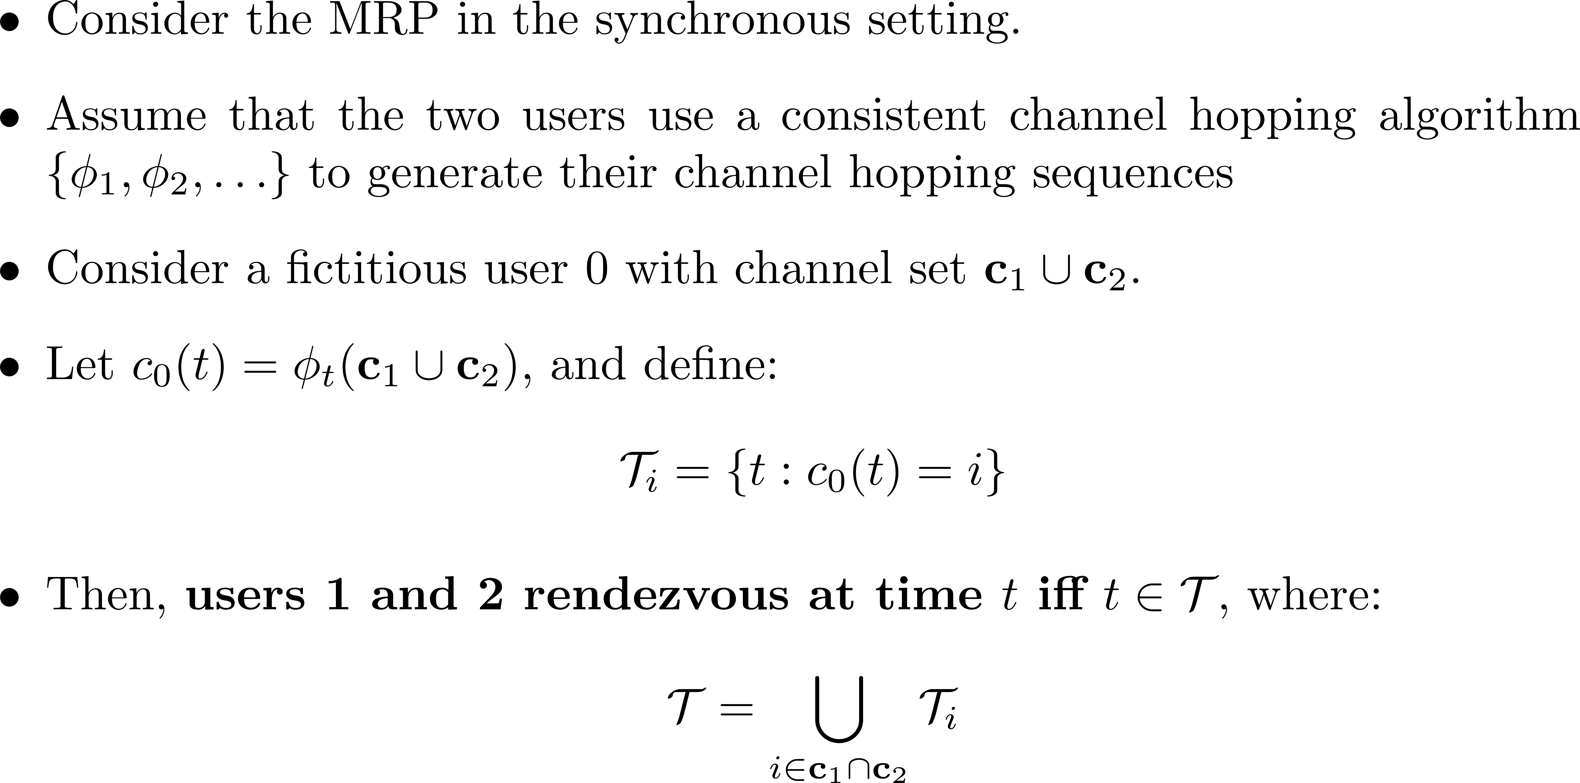
Characterization of the set of rendezvous time slots
5

Slide 6
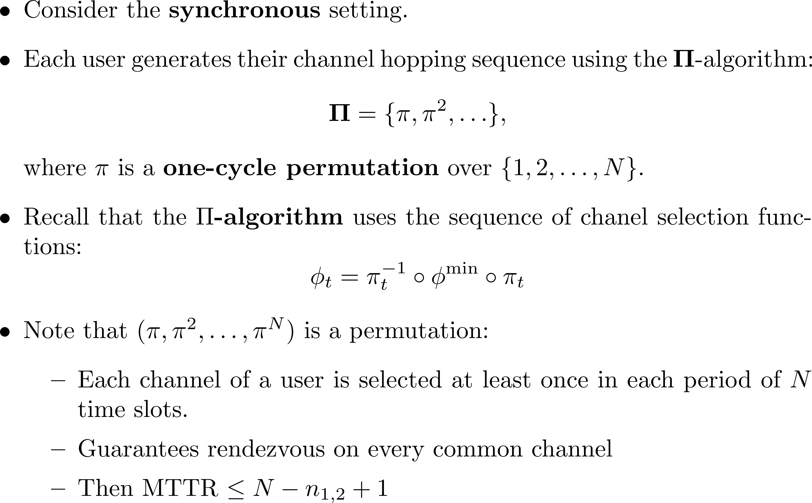
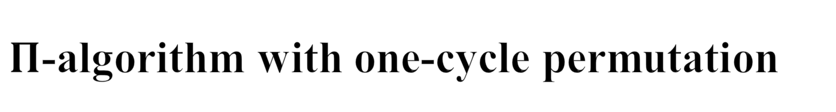
$Π$-algorithm with one-cycle permutation
6

Slide 7
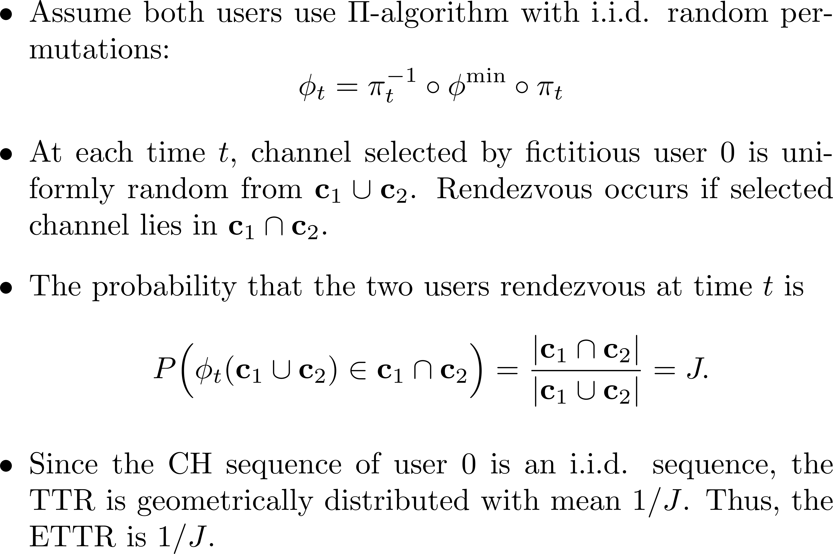

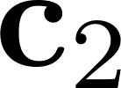
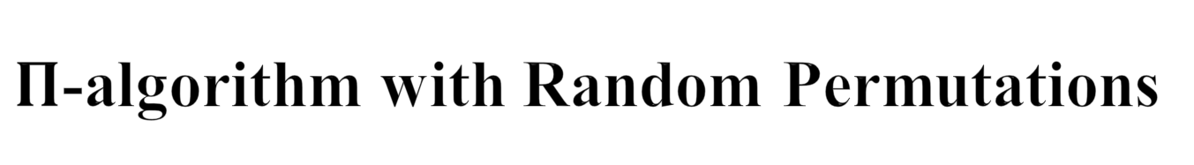
$Π$-algorithm with Random Permutations
7

Slide 8
Direct extension to multiple users
8

Slide 9
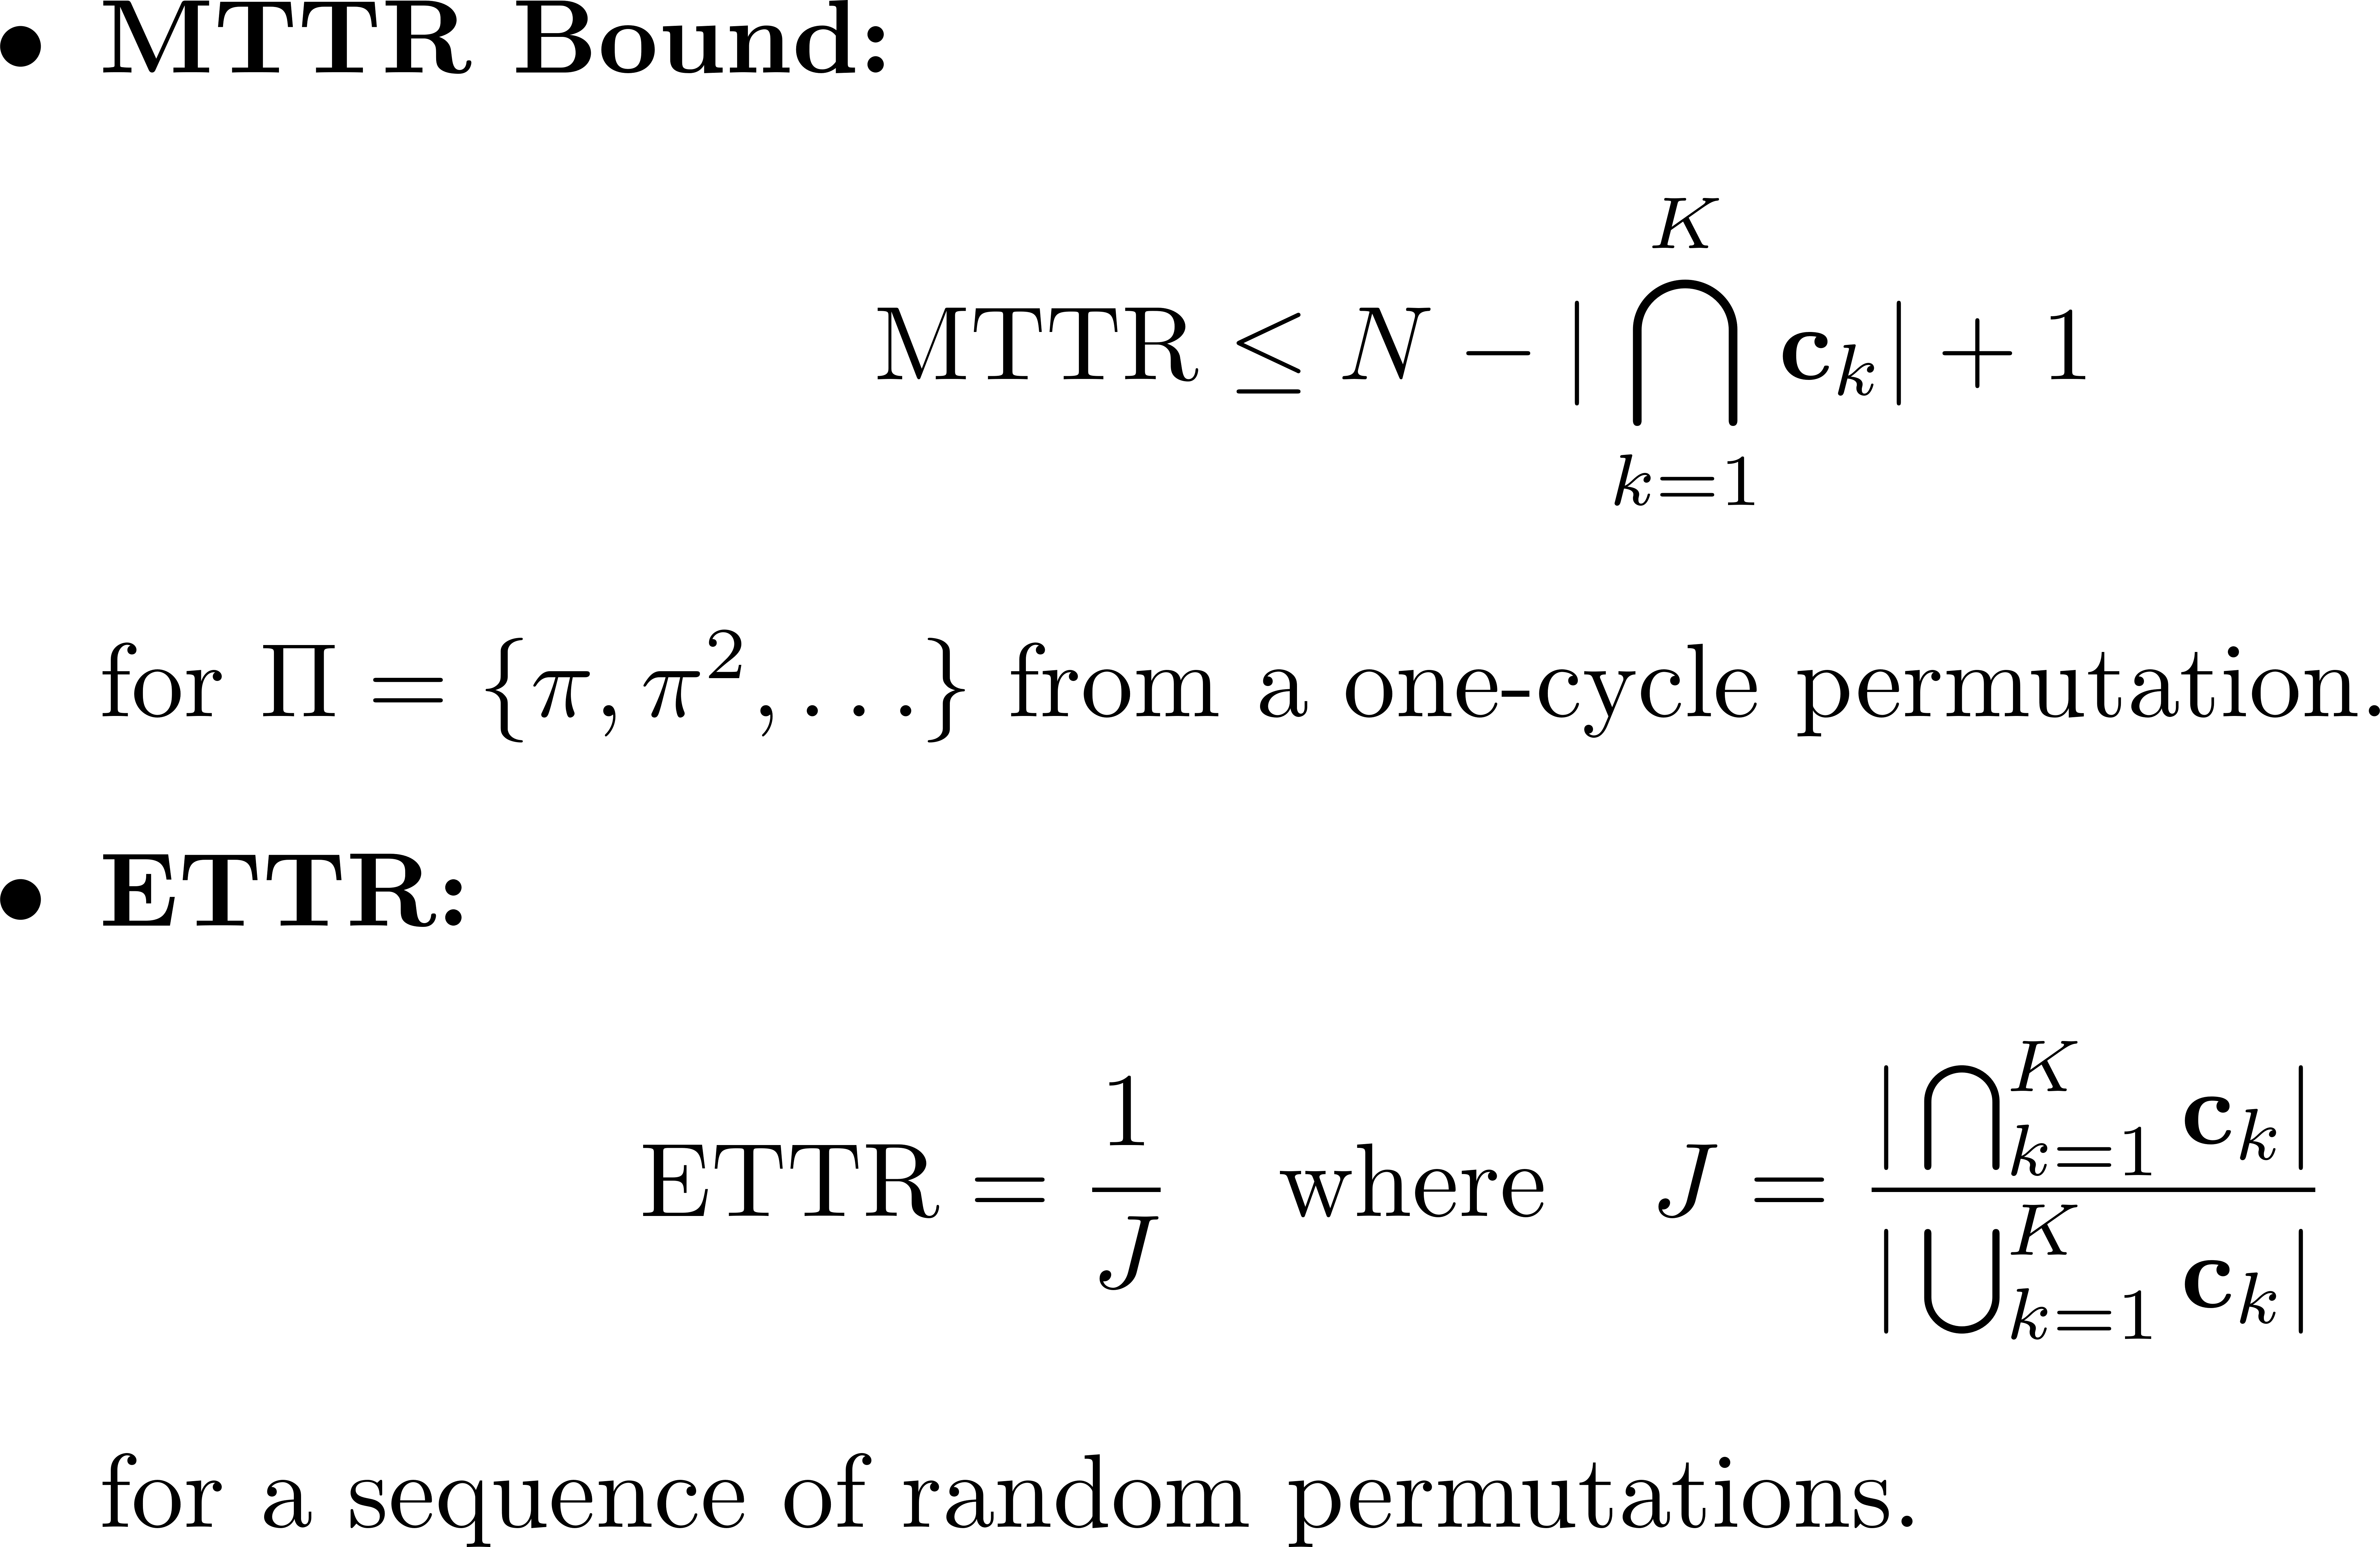
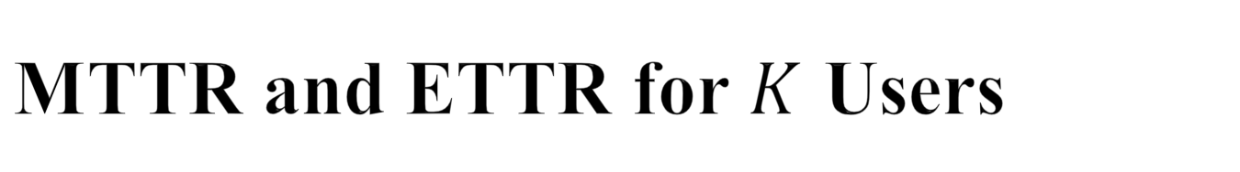
MTTR and ETTR for $K$ Users
Generalized Jaccard index
9

Slide 10
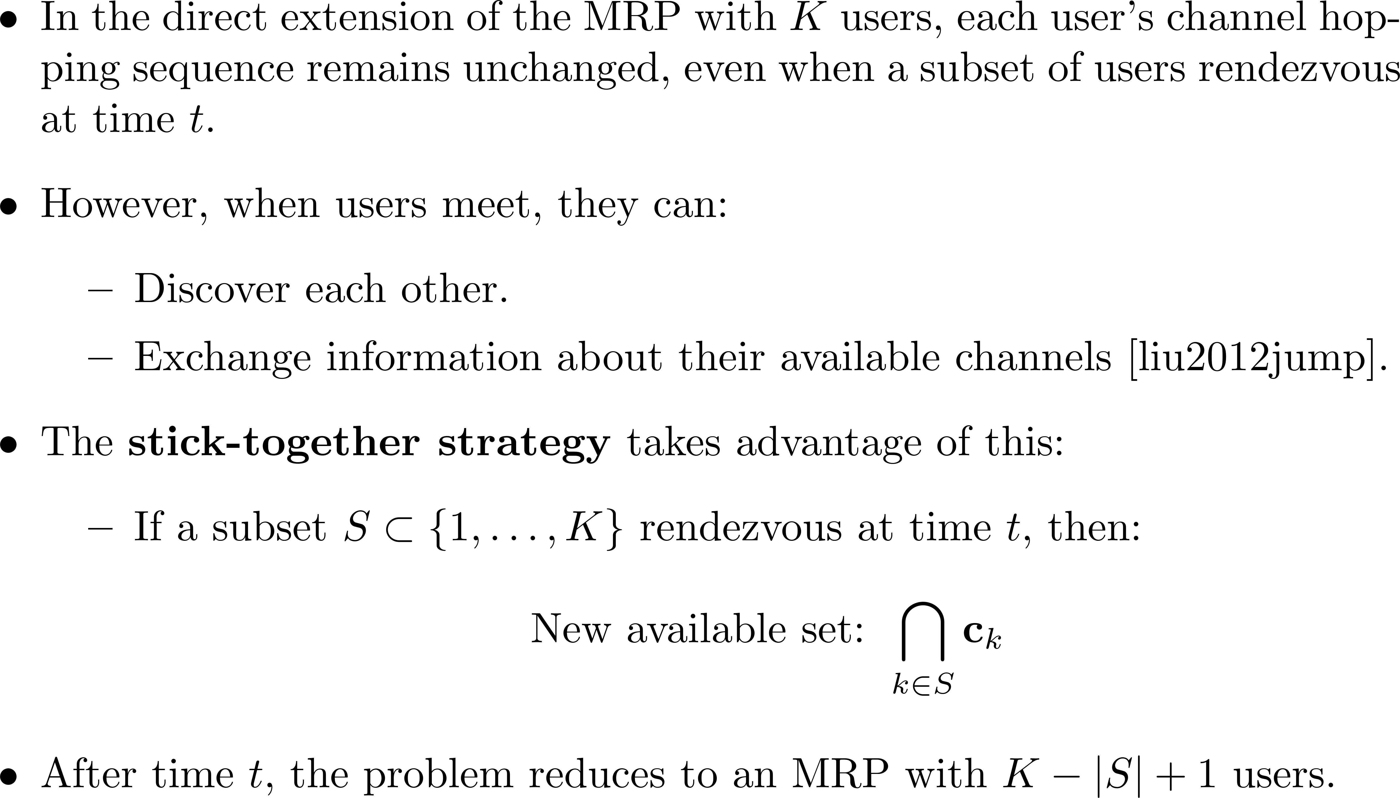
Stick-together strategy

Slide 11
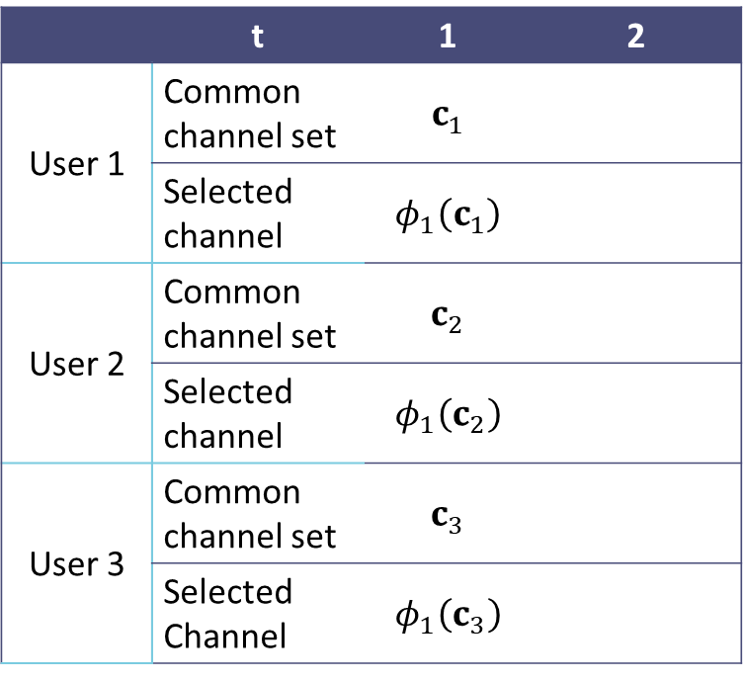
Stick-together strategy
 | t | 1 | 2
User 1 | Common channel set | $$c_{1}$$
 | Selected channel | $$φ_{1}\left(c_{1}\right)$$
User 2 | Common channel set | $$c_{2}$$
 | Selected channel | $$φ_{1}\left(c_{2}\right)$$
User 3 | Common channel set | $$c_{3}$$
 | Selected Channel | $$φ_{1}\left(c_{3}\right)$$
Initialize the (known) common channel set as the available channel set
Select a channel from the (known) common channel set.
11

Slide 12
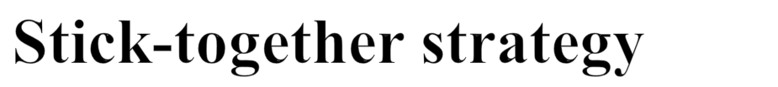
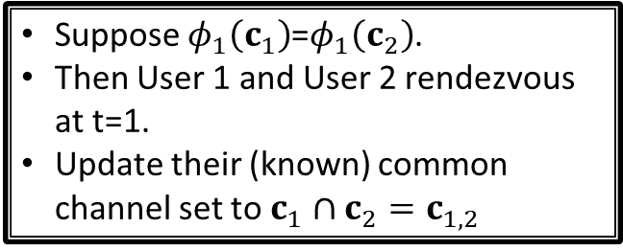
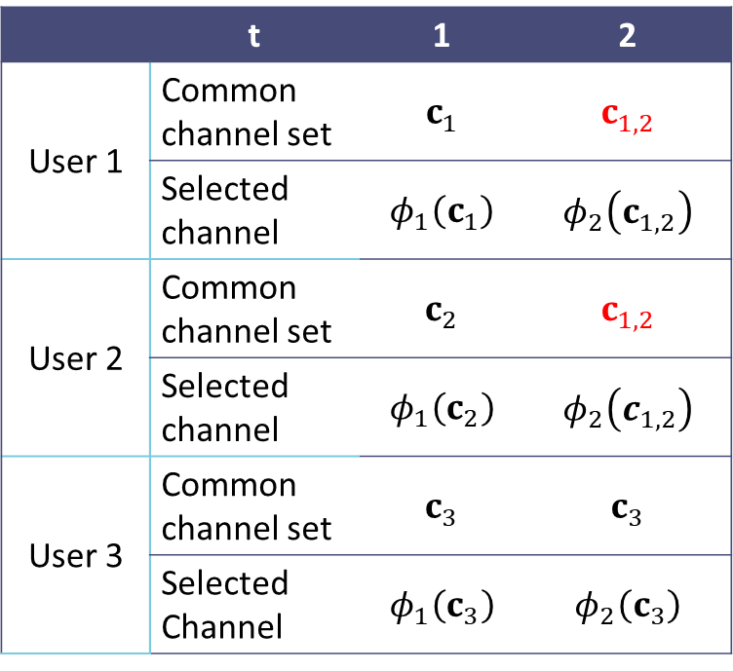
 | t | 1 | 2
User 1 | Common channel set | $$c_{1}$$ | $$c_{1,2}$$
 | Selected channel | $$φ_{1}\left(c_{1}\right)$$ | $$φ_{2}\left(c_{1,2}\right)$$
User 2 | Common channel set | $$c_{2}$$ | $$c_{1,2}$$
 | Selected channel | $$φ_{1}\left(c_{2}\right)$$ | $$φ_{2}\left(c_{1,2}\right)$$
User 3 | Common channel set | $$c_{3}$$ | $$c_{3}$$
 | Selected Channel | $$φ_{1}\left(c_{3}\right)$$ | $$φ_{2}\left(c_{3}\right)$$
Suppose $φ_{1}\left(c_{1}\right)$=$φ_{1}\left(c_{2}\right)$.
Then User 1 and User 2 rendezvous at t=1.
Update their (known) common channel set to $c_{1}$ $∩c_{2}=c_{1,2}$
12

Slide 13
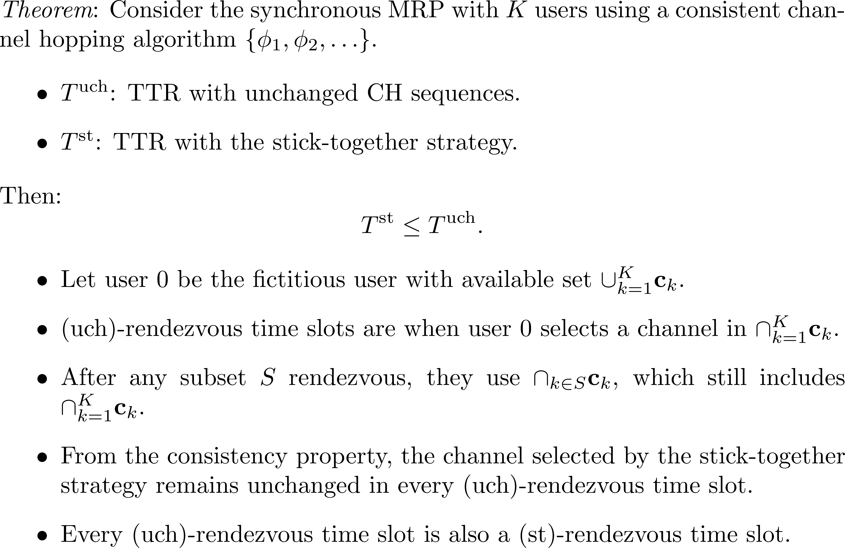

Slide 14
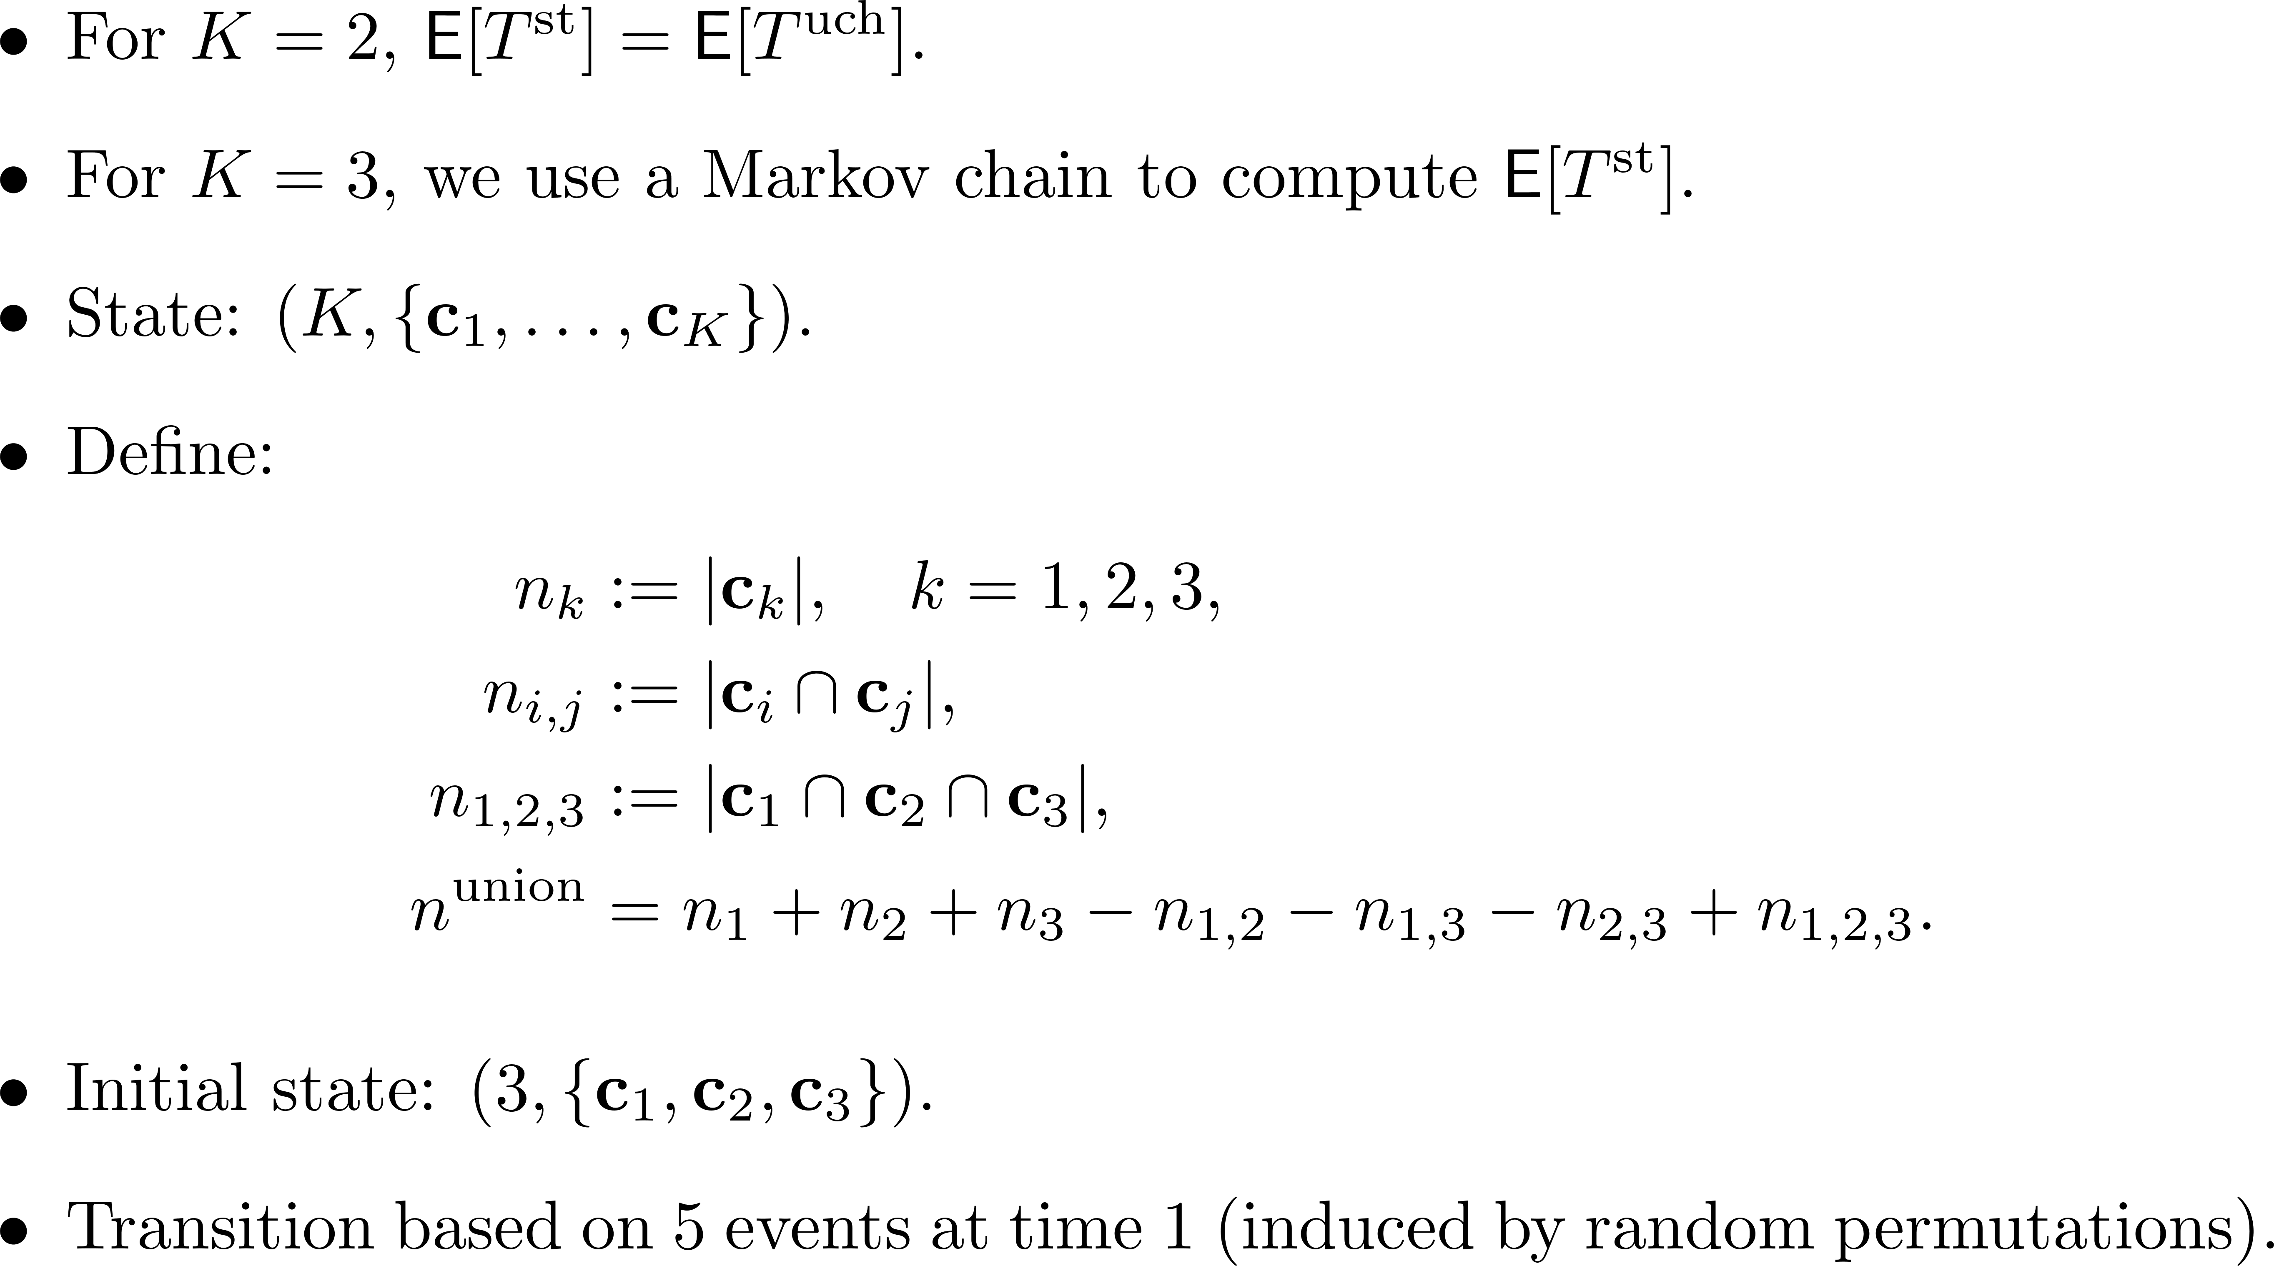
Exact analysis for the ETTR of the stick-together strategy when K=3

Slide 15
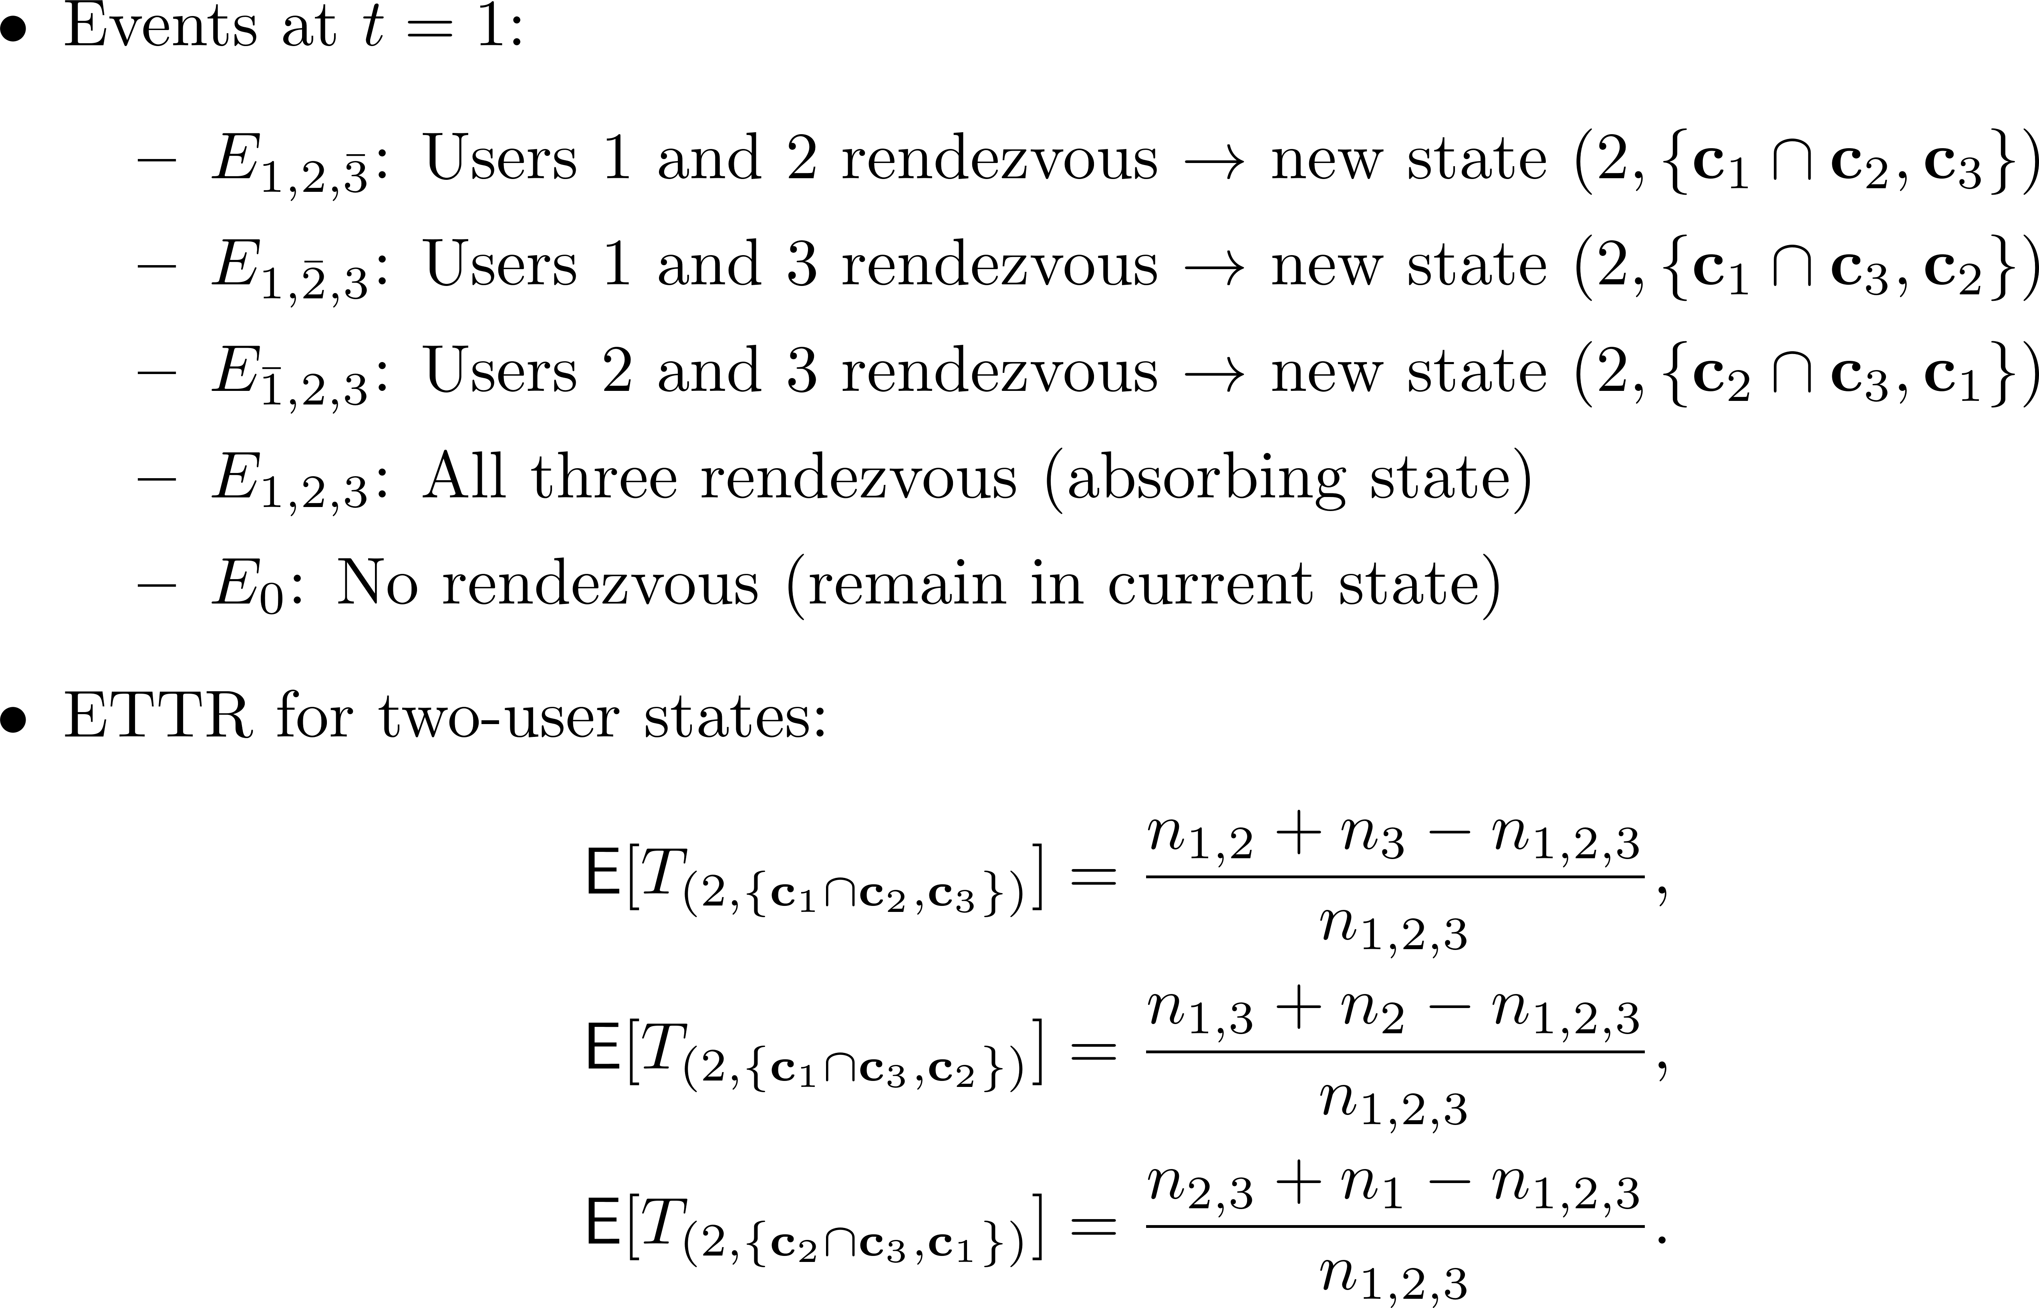
The inverse of the Jaccard index

Slide 16
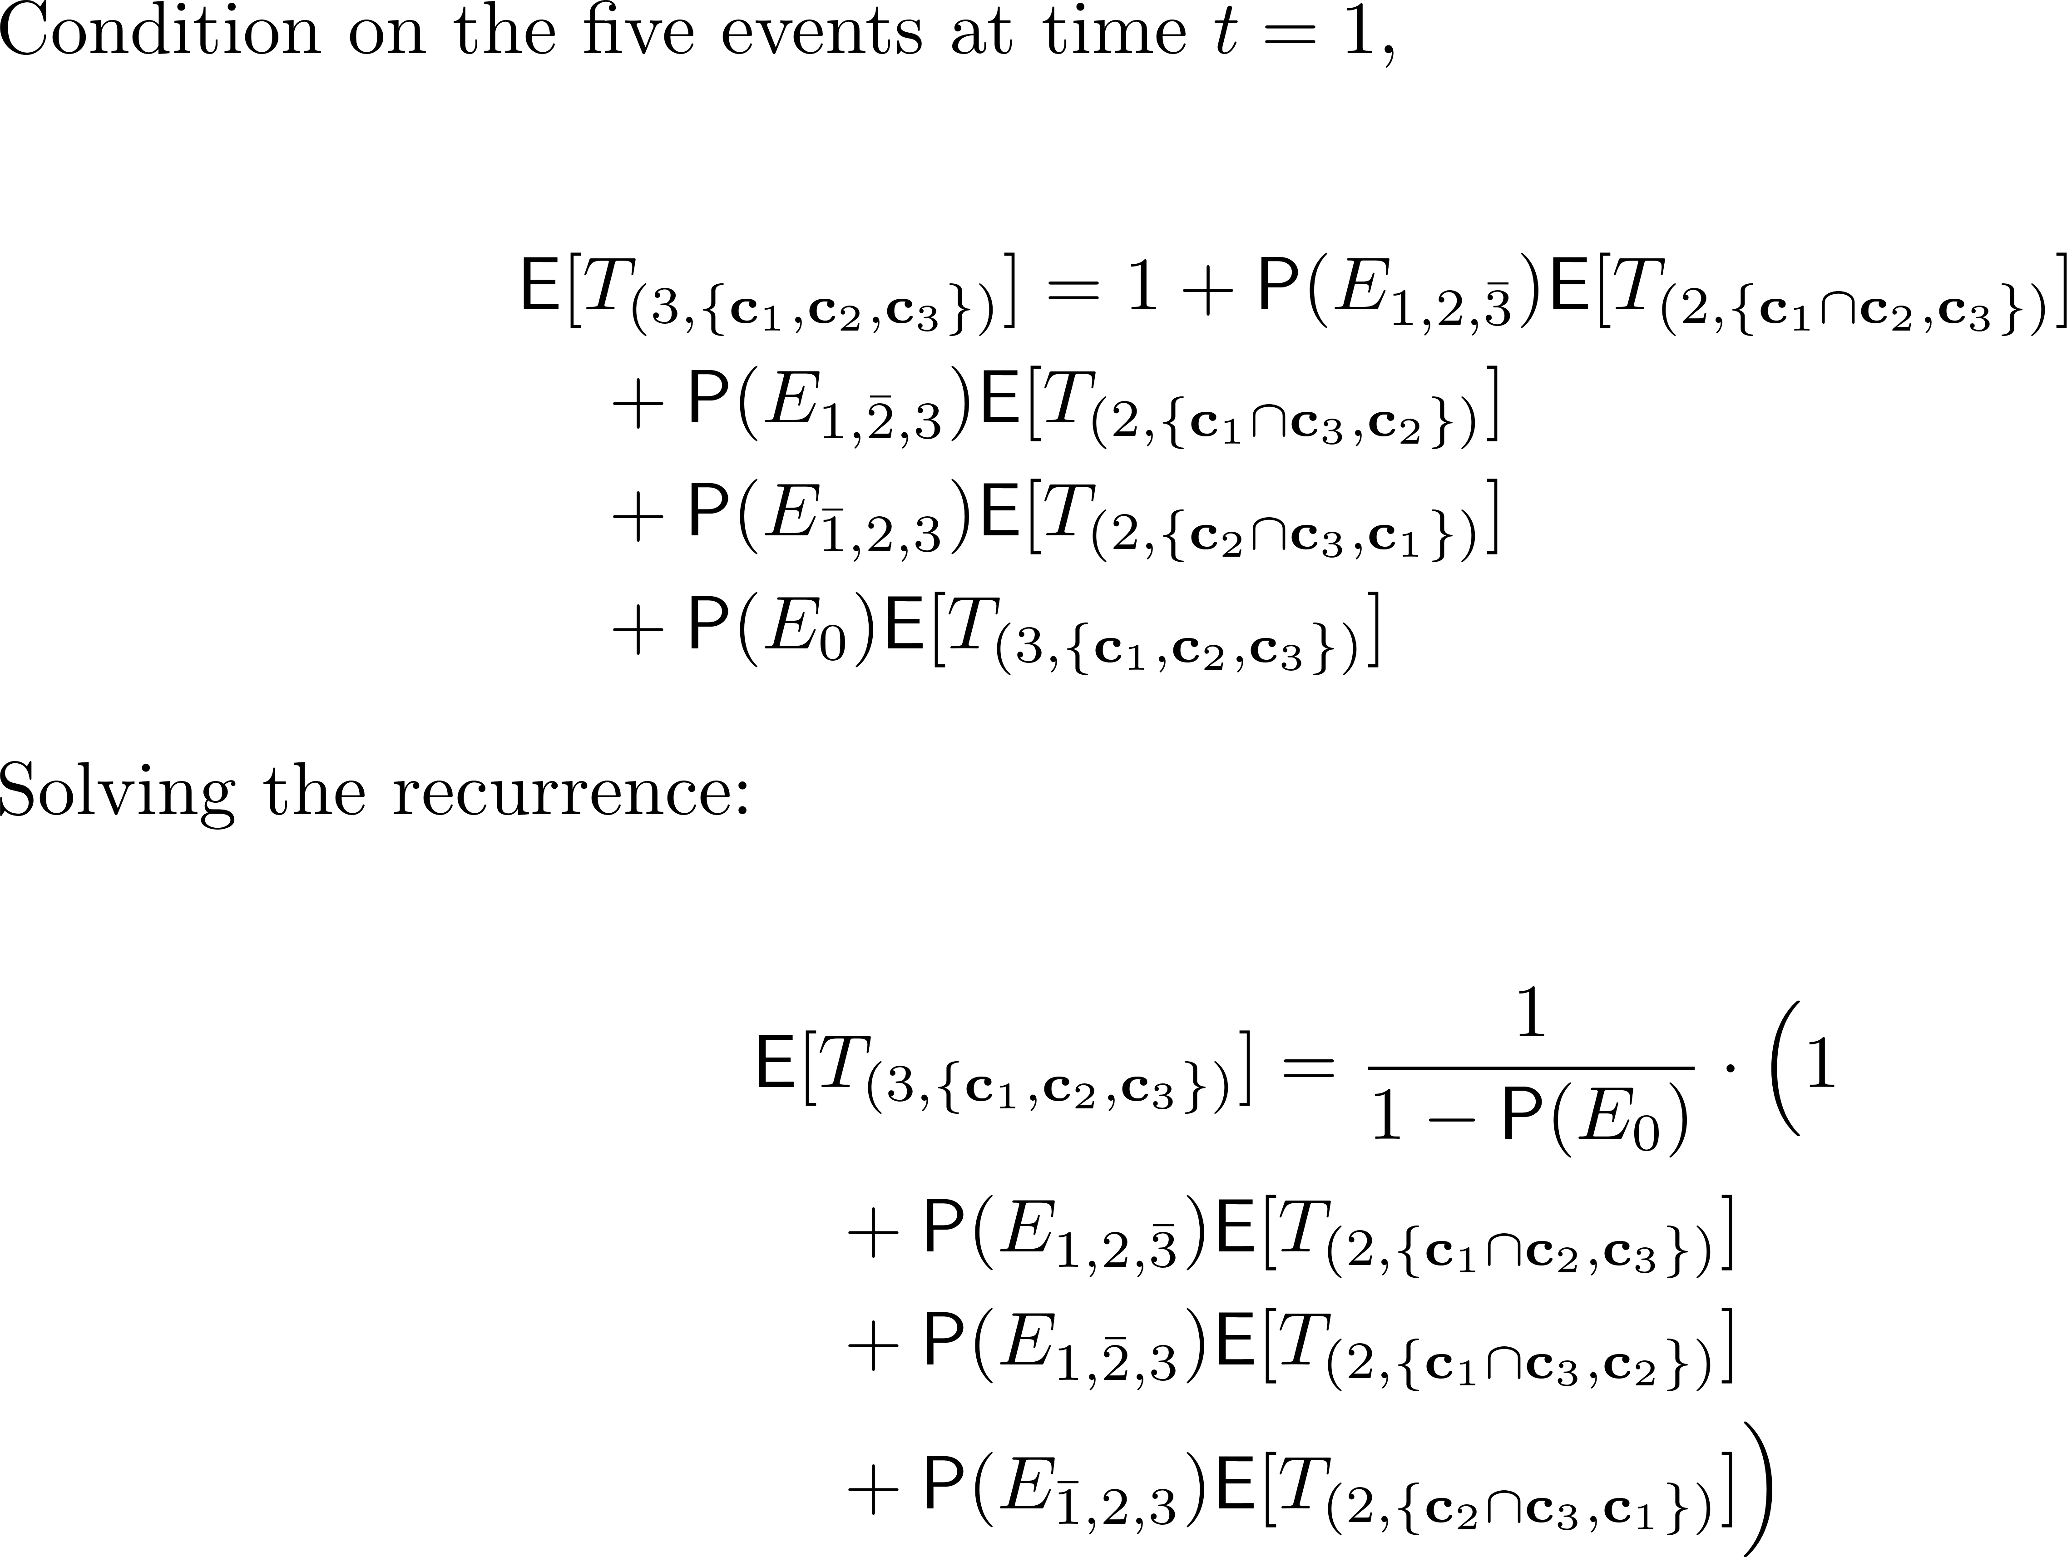

Slide 17
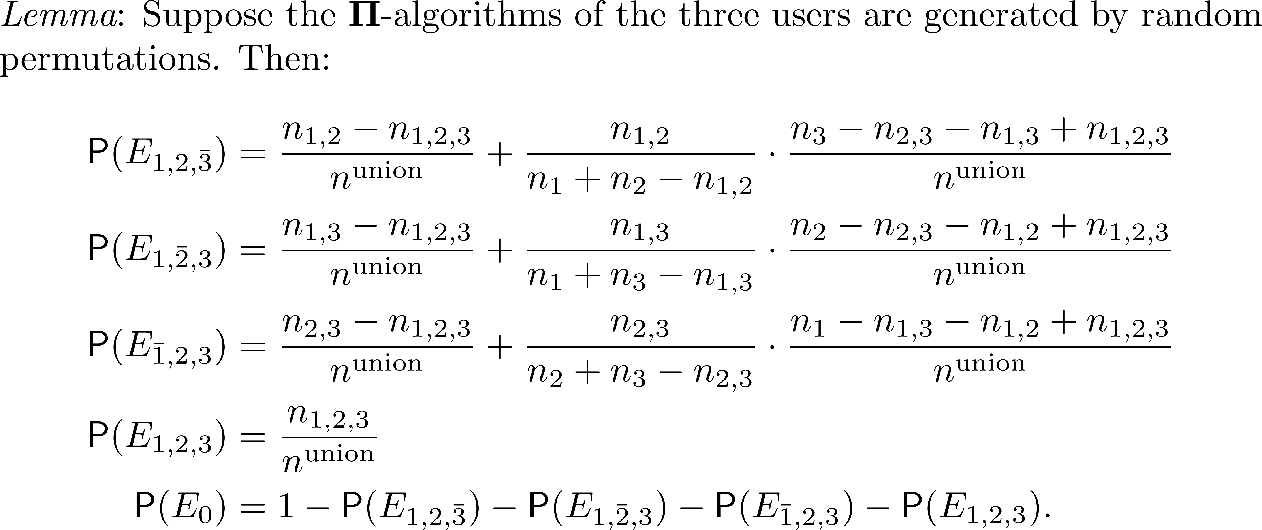
Event probabilities under random permutations

Slide 18
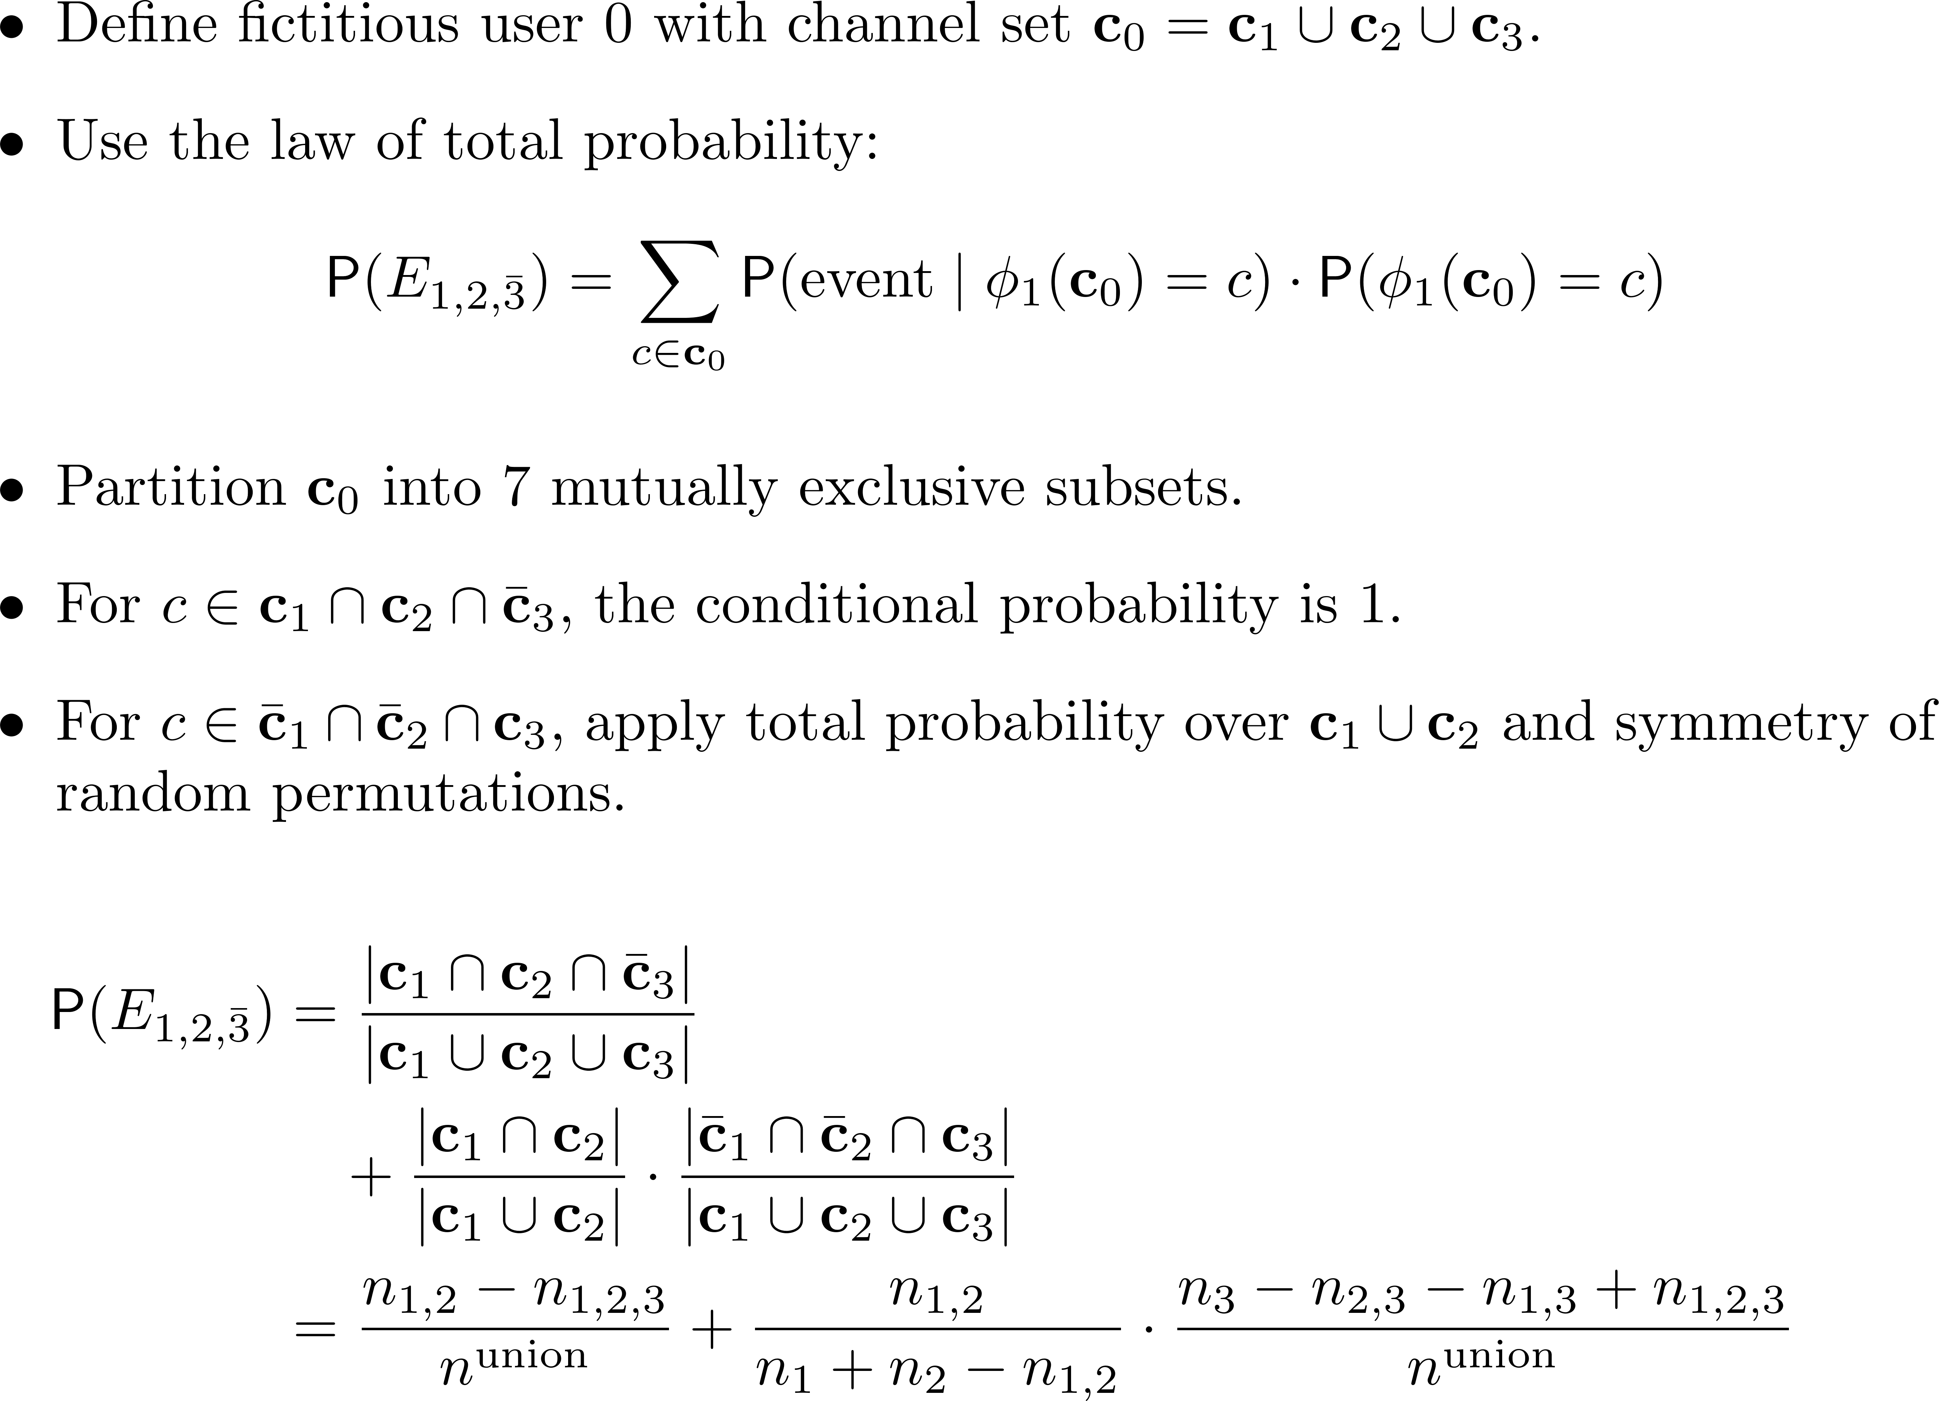
1
2
3

Slide 19
Spread-out strategy for three users
Use pairwise rendezvous to gather the information of available channel sets
19

Slide 20
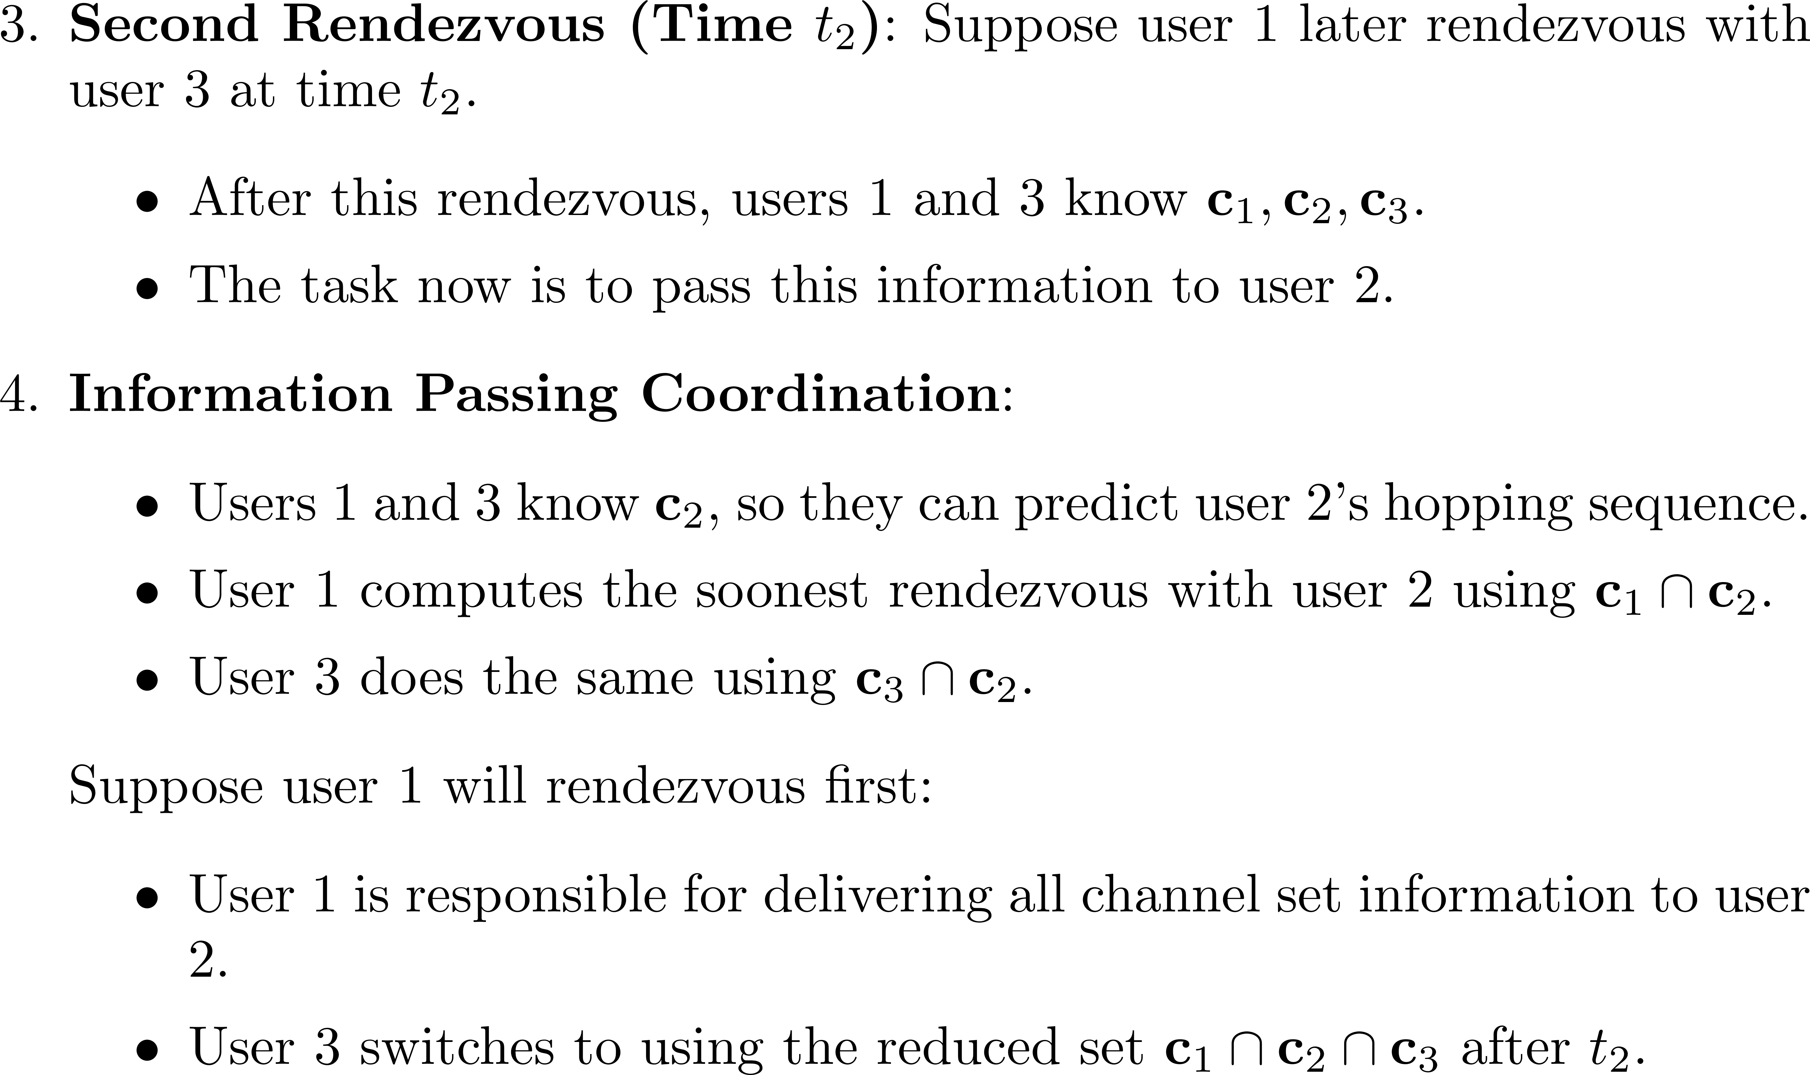
Spread-out strategy for three users

Slide 21
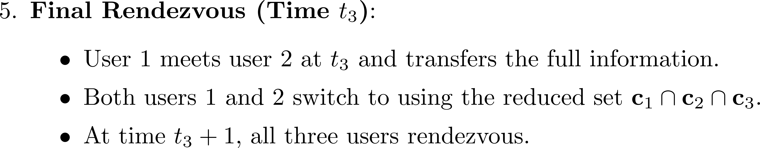
Spread-out strategy for three users

Slide 22
Spread-out strategy for three users
First Rendezvous
User 1
Each user selects a channel from its own available channel set.
User 2
User 3
22

Slide 23
Spread-out strategy for three users
First Rendezvous
Second Rendezvous
Users 1 and 3 can predict when one of them can meet User 2
Pass the information of available channel sets to User 2
User 1
User 1
User 2
User 3
User 2
User 3
Too complex to extend to more than three users.
23

Slide 24
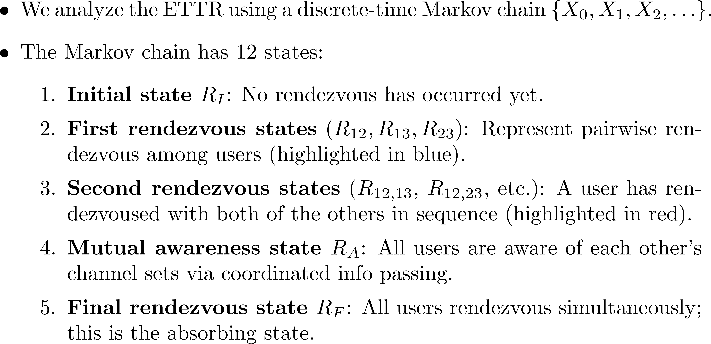
Markov chain model for the spread-out strategy with 3 users

Slide 25
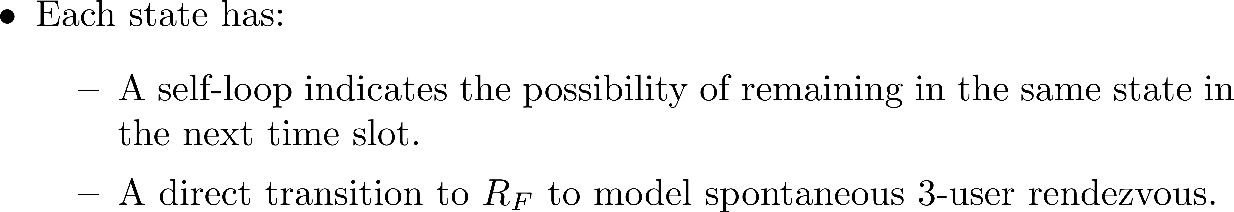
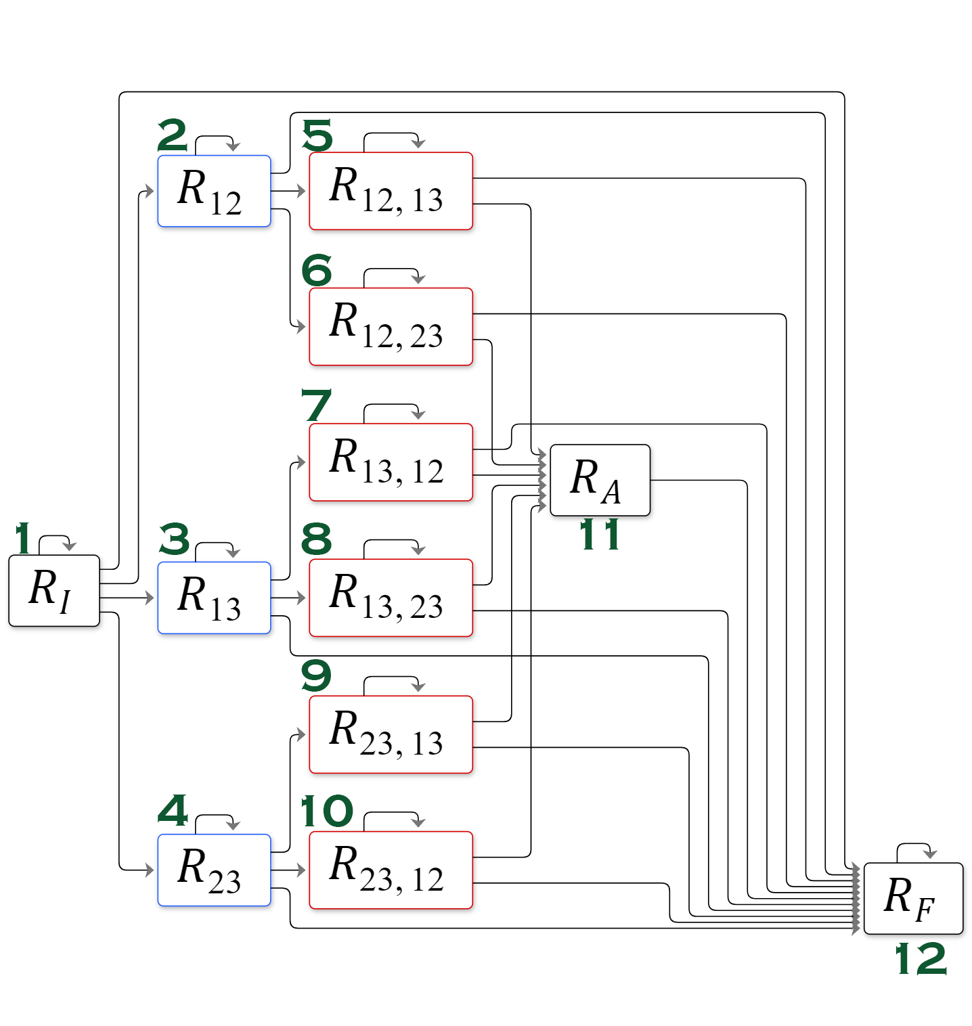
The state transition diagram for the rendezvous process with the spread-out strategy

Slide 26
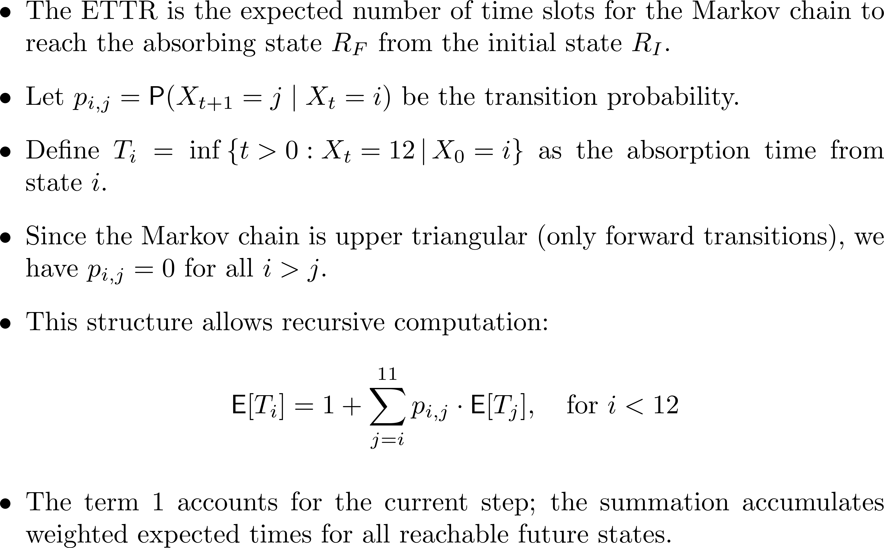

Slide 27
Hybrid Strategy: Alternating Between Stick-Together and Spread-Out
27

Slide 28
Hybrid Strategy: Alternating Between Stick-Together and Spread-Out
Why?
28

Slide 29
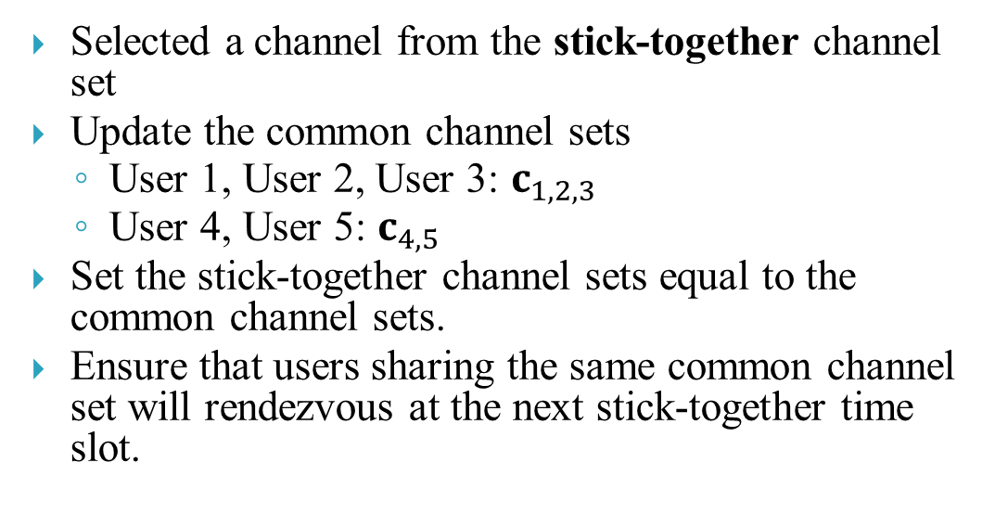
An illustrating example for the hybrid strategy
t=1
Stick-Together
Selected a channel from the stick-together channel set
Update the common channel sets
  User 1, User 2, User 3: $c_{1,2,3}$
  User 4, User 5: $c_{4,5}$
Set the stick-together channel sets equal to the common channel sets.
Ensure that users sharing the same common channel set will rendezvous at the next stick-together time slot.
User 1
User 2
User 3
User 4
User 5
29

Slide 30
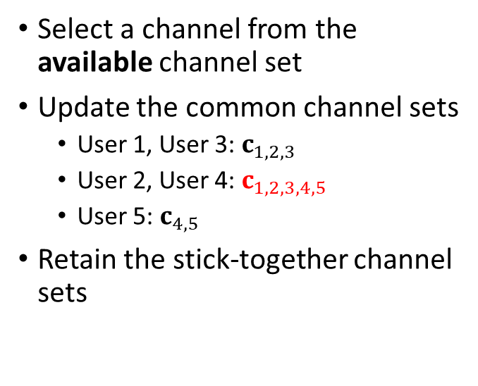
An illustrating example for the hybrid strategy
t=2
Stick-Together
Spread-Out
Select a channel from the available channel set
Update the common channel sets
  User 1, User 3: $c_{1,2,3}$
  User 2, User 4: $c_{1,2,3,4,5}$
  User 5: $c_{4,5}$
Retain the stick-together channel sets
User 1
User 1
User 2
User 3
User 2
User 3
User 4
User 5
User 4
User 5
30

Slide 31

An illustrating example for the hybrid strategy
Stick-Together
Spread-Out
Stick-Together
User 1
User 1
User 1
At t=3, Users 1–5 now share the same common and stick-together channel sets$c_{1,2,3,4,5}$
They are guaranteed to rendezvous at the next stick-together time slot.
User 2
User 3
User 2
User 3
User 2
User 3
User 4
User 5
User 4
User 5
User 4
User 5
31

Slide 32
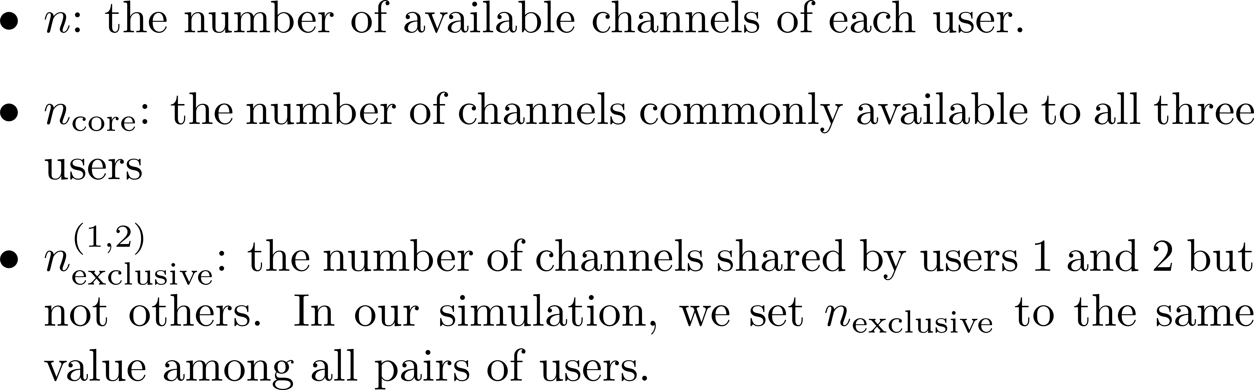



Simulation

Slide 33
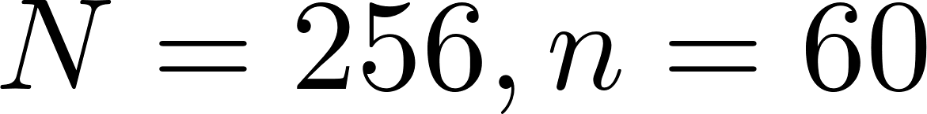
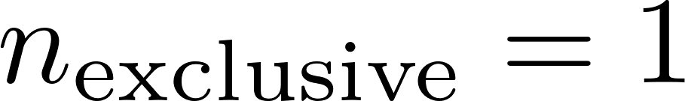
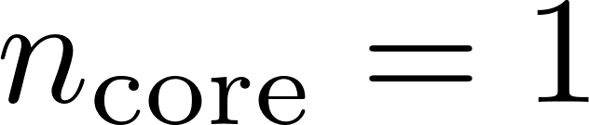
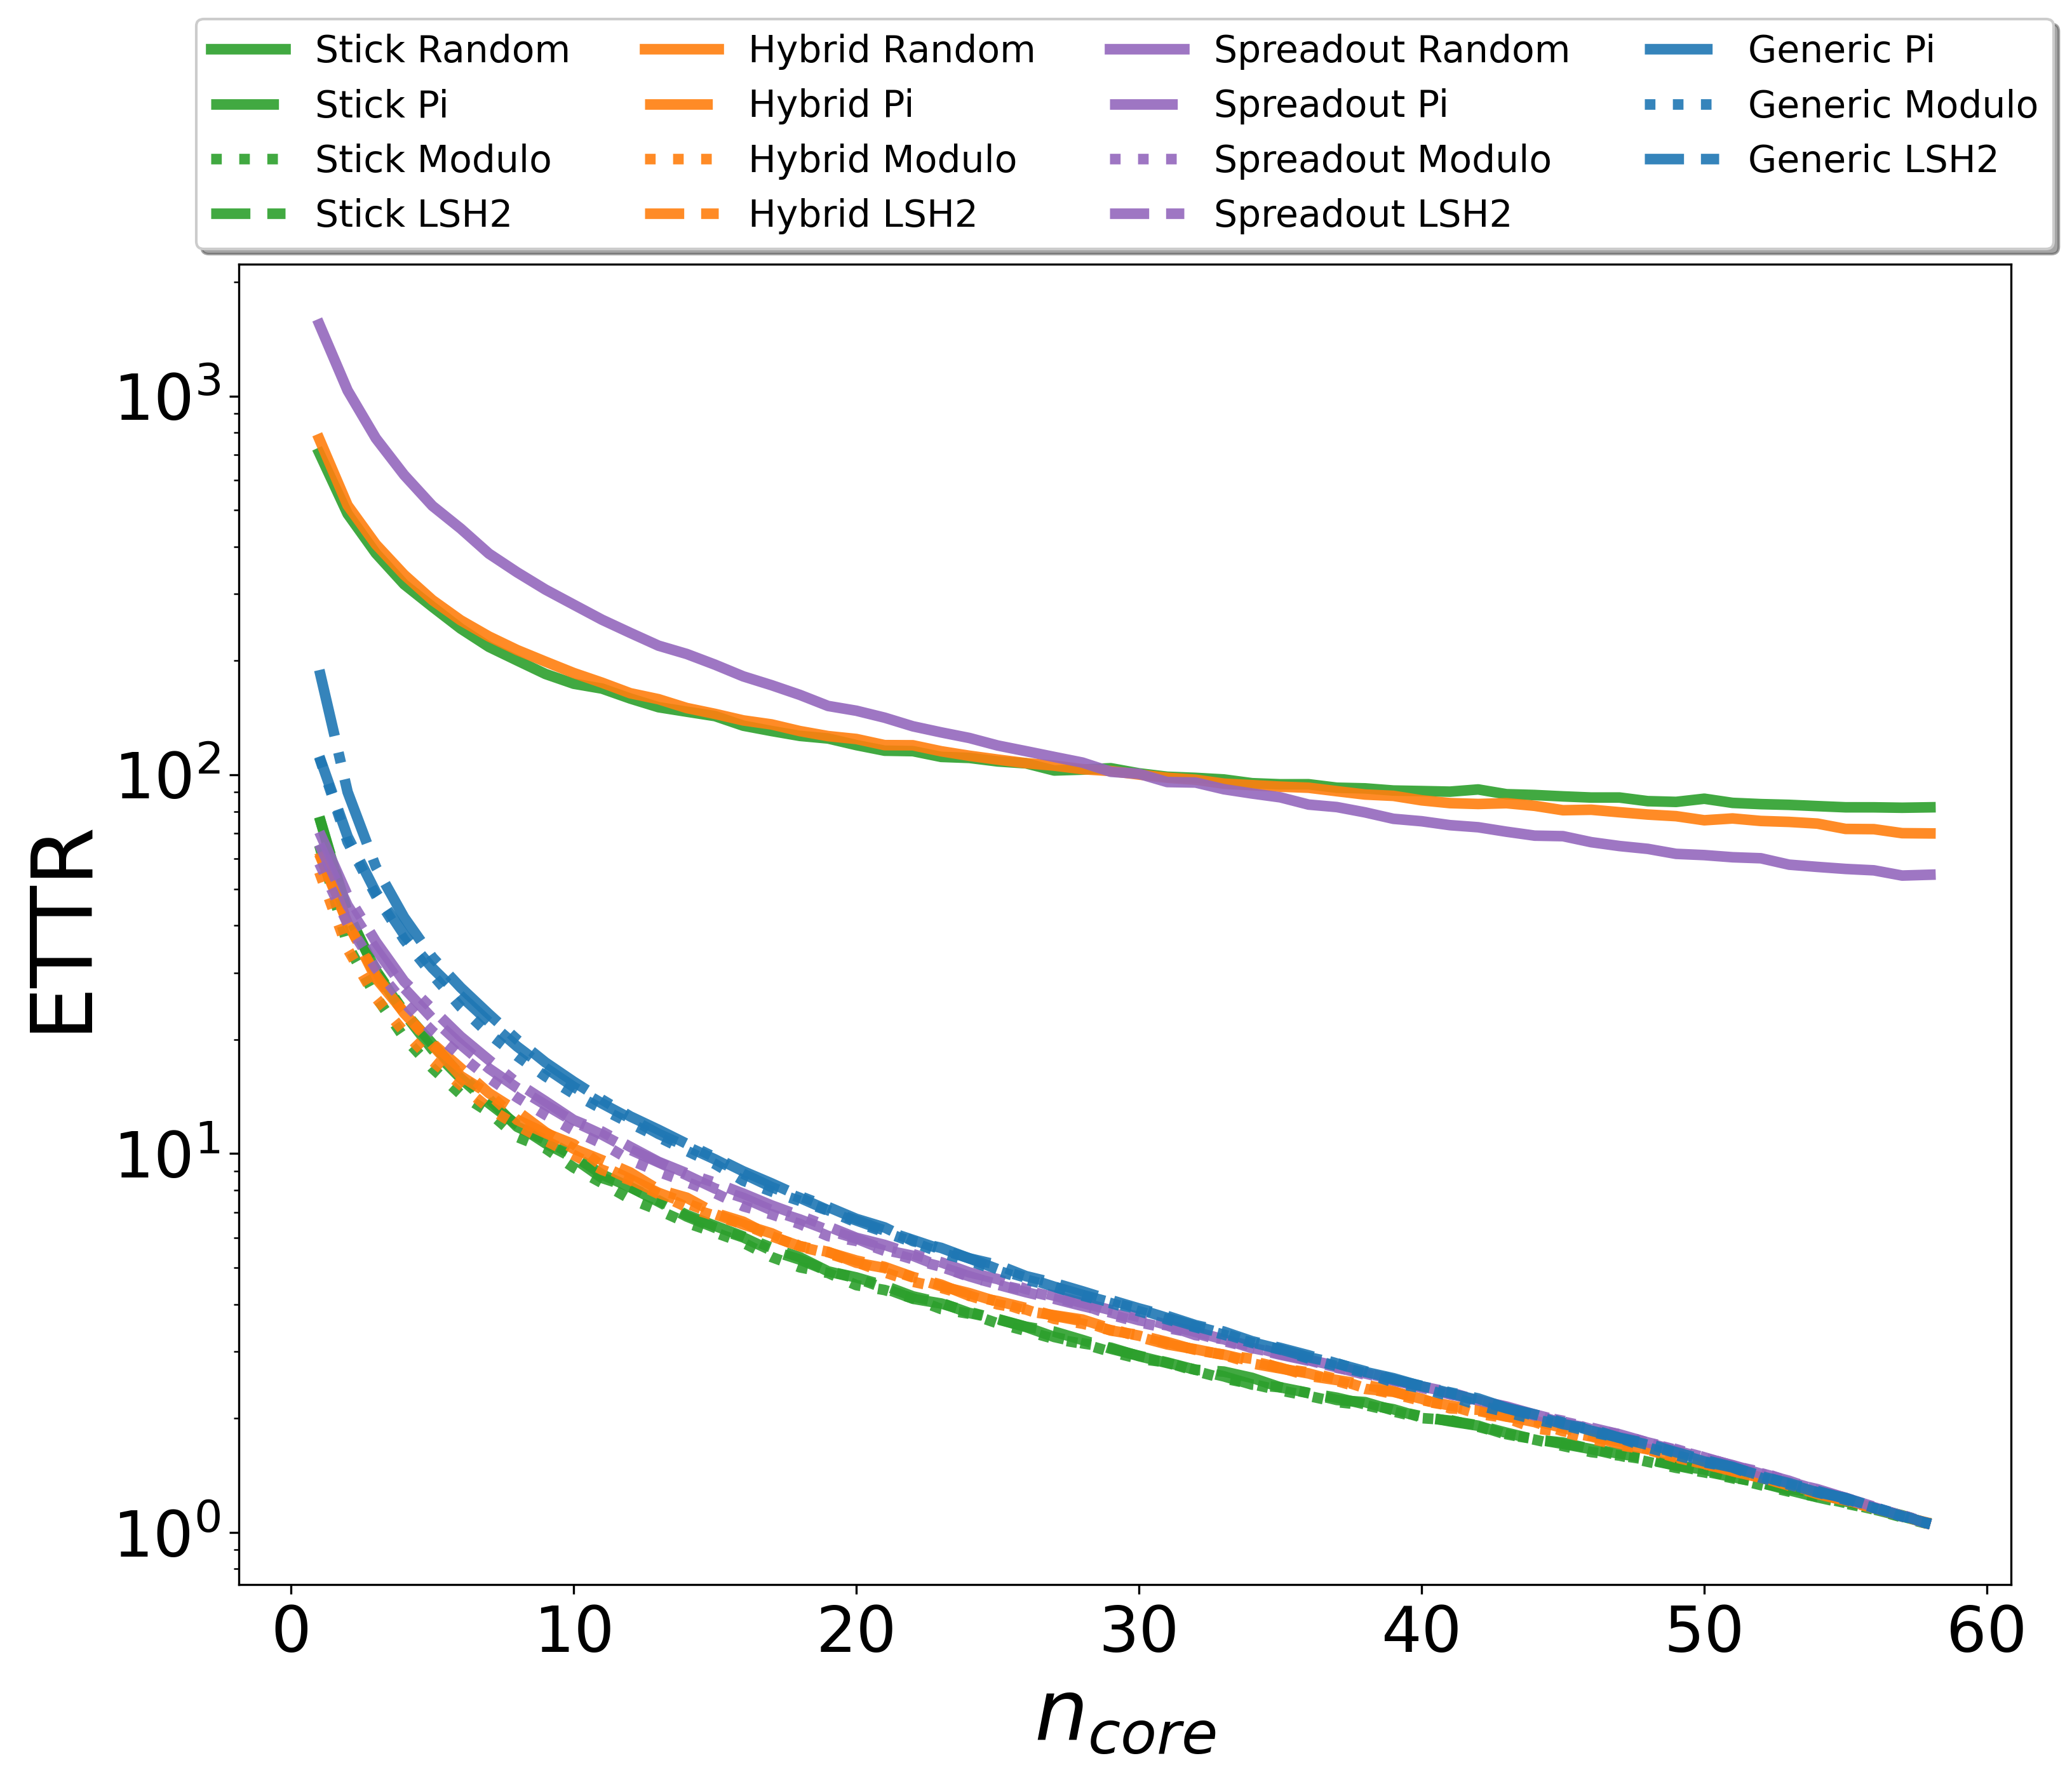
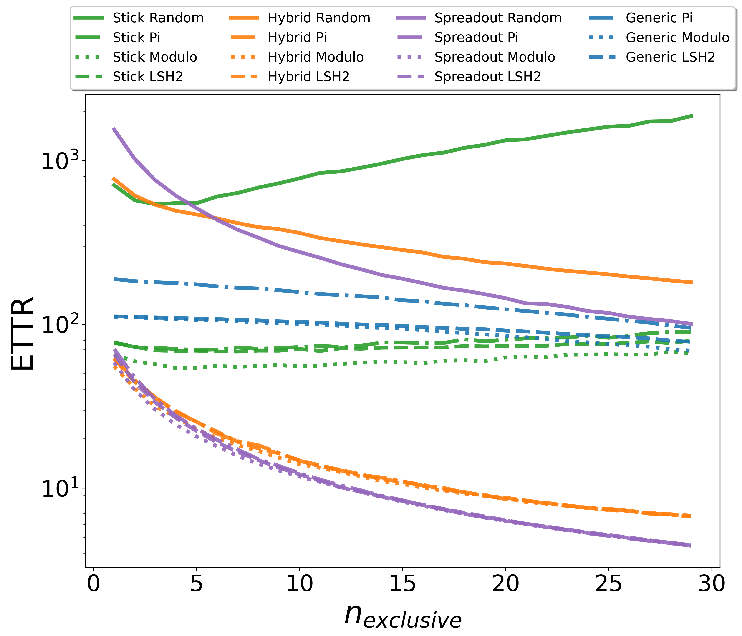
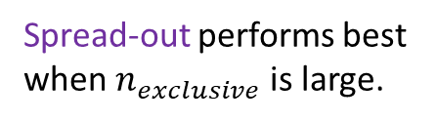
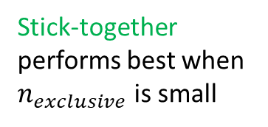
Simulation: 3 users / Sync / ETTR
Stick-together performs best when $n_{exclusive}$is small
Spread-out performs best when $n_{exclusive}$is large.
33

Slide 34
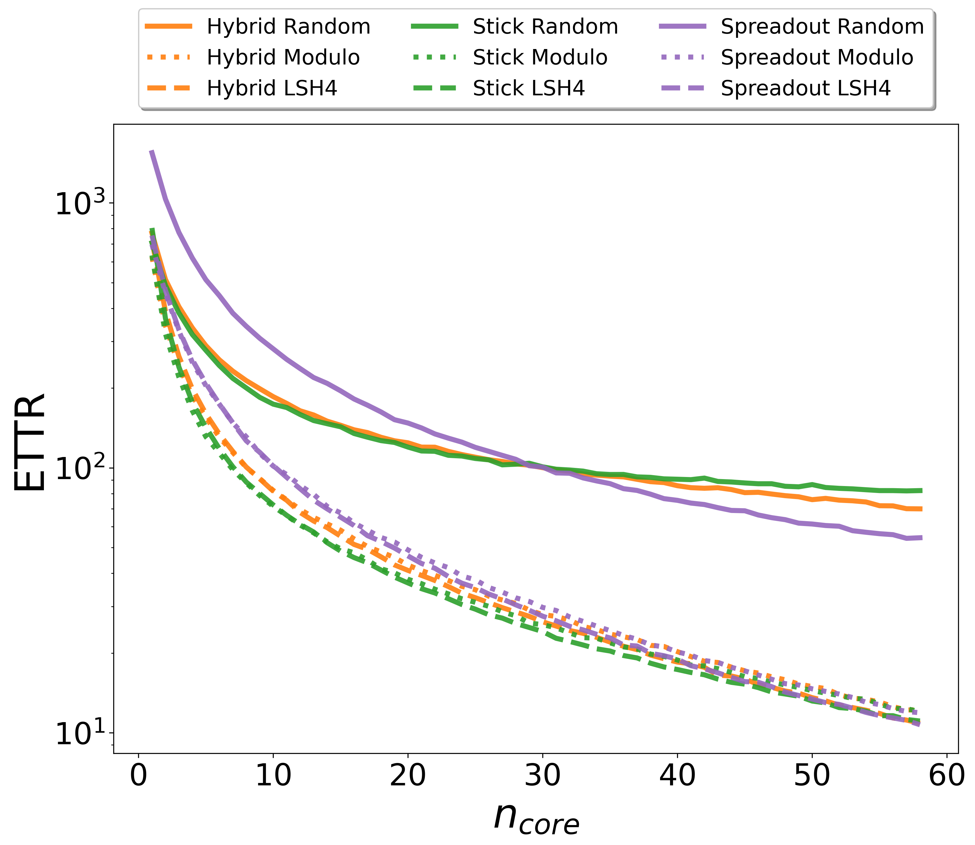
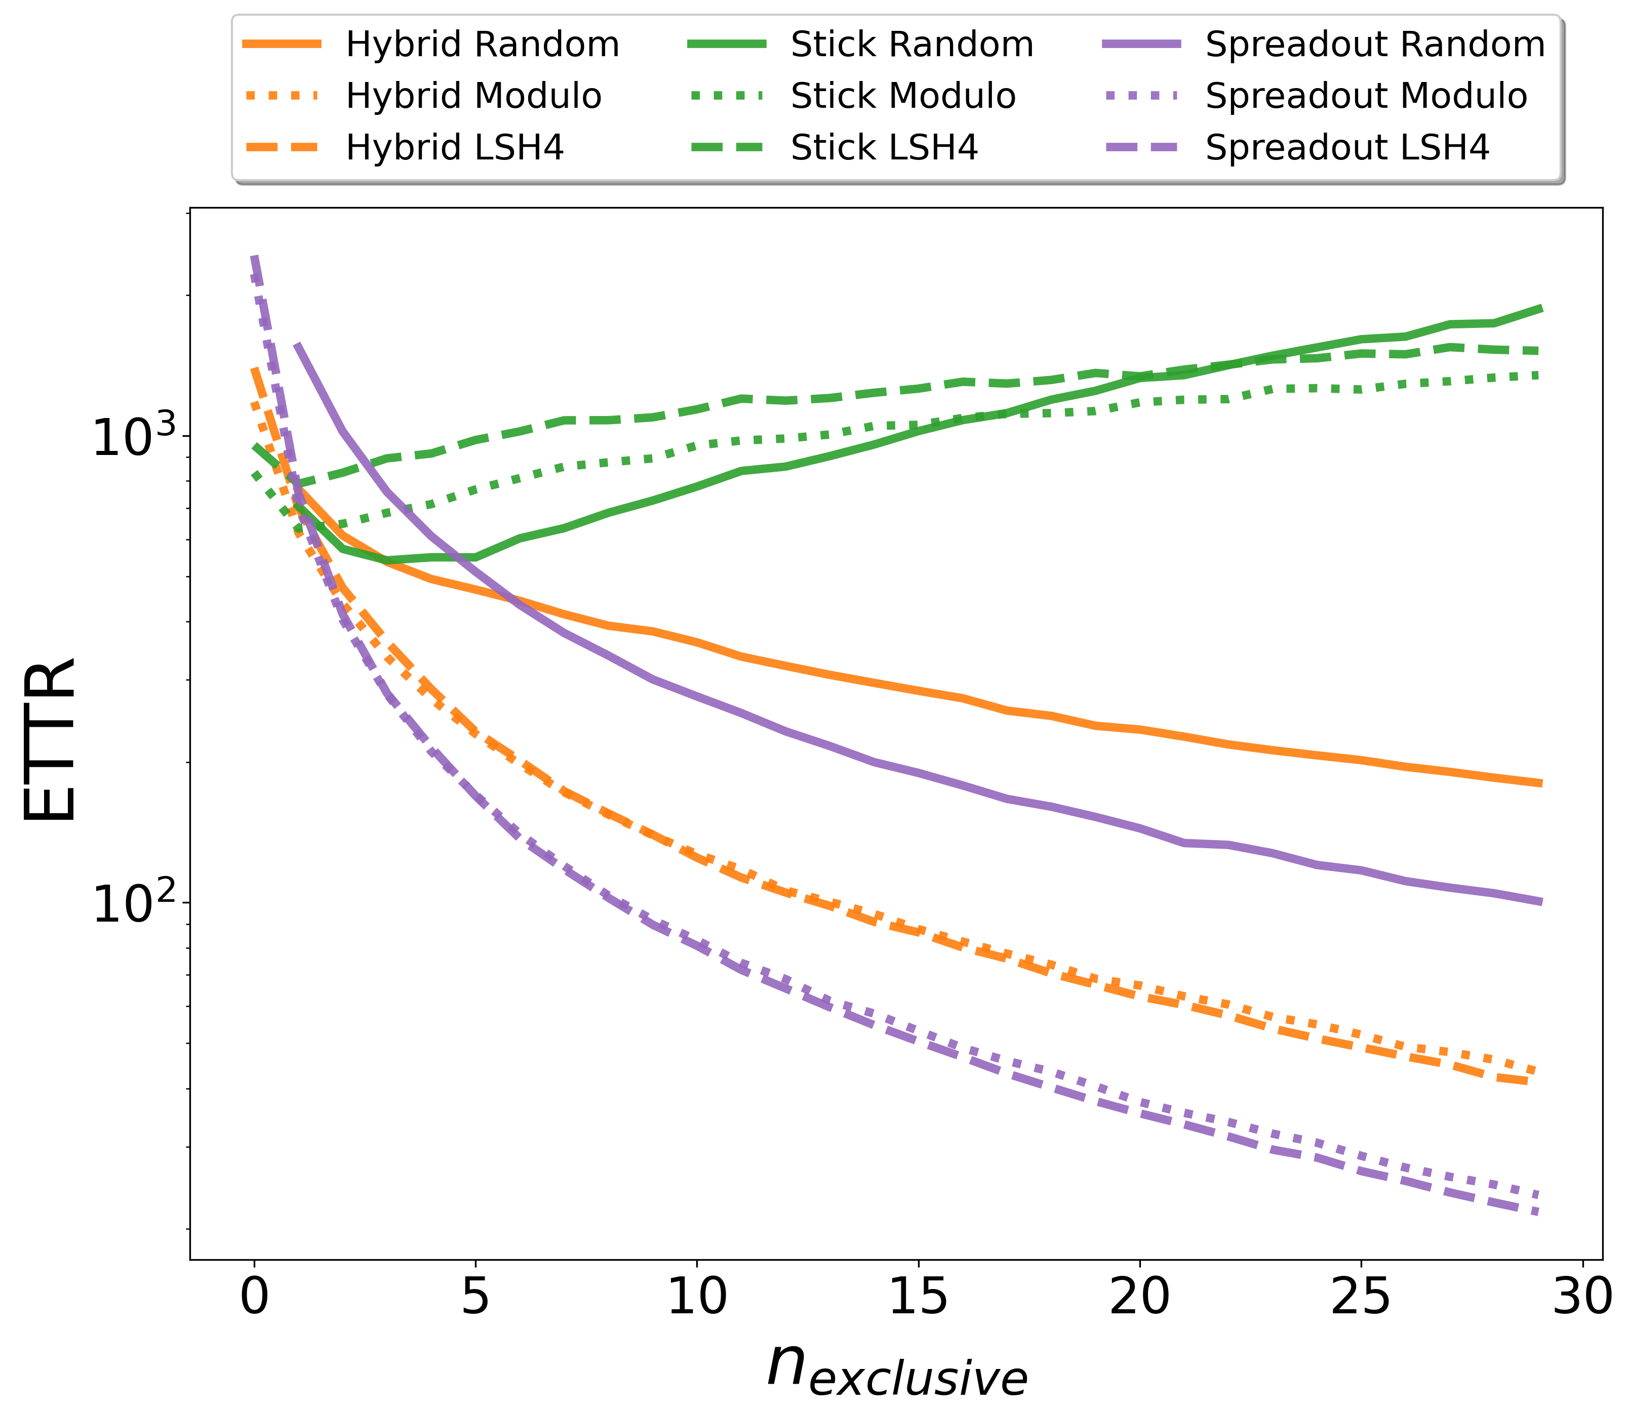

Simulation: 3 users / Async / ETTR
Stick-together performs best when $n_{exclusive}$is small
Spread-out performs best when $n_{exclusive}$is large.
34

Slide 35
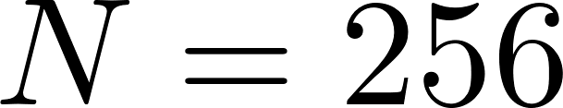
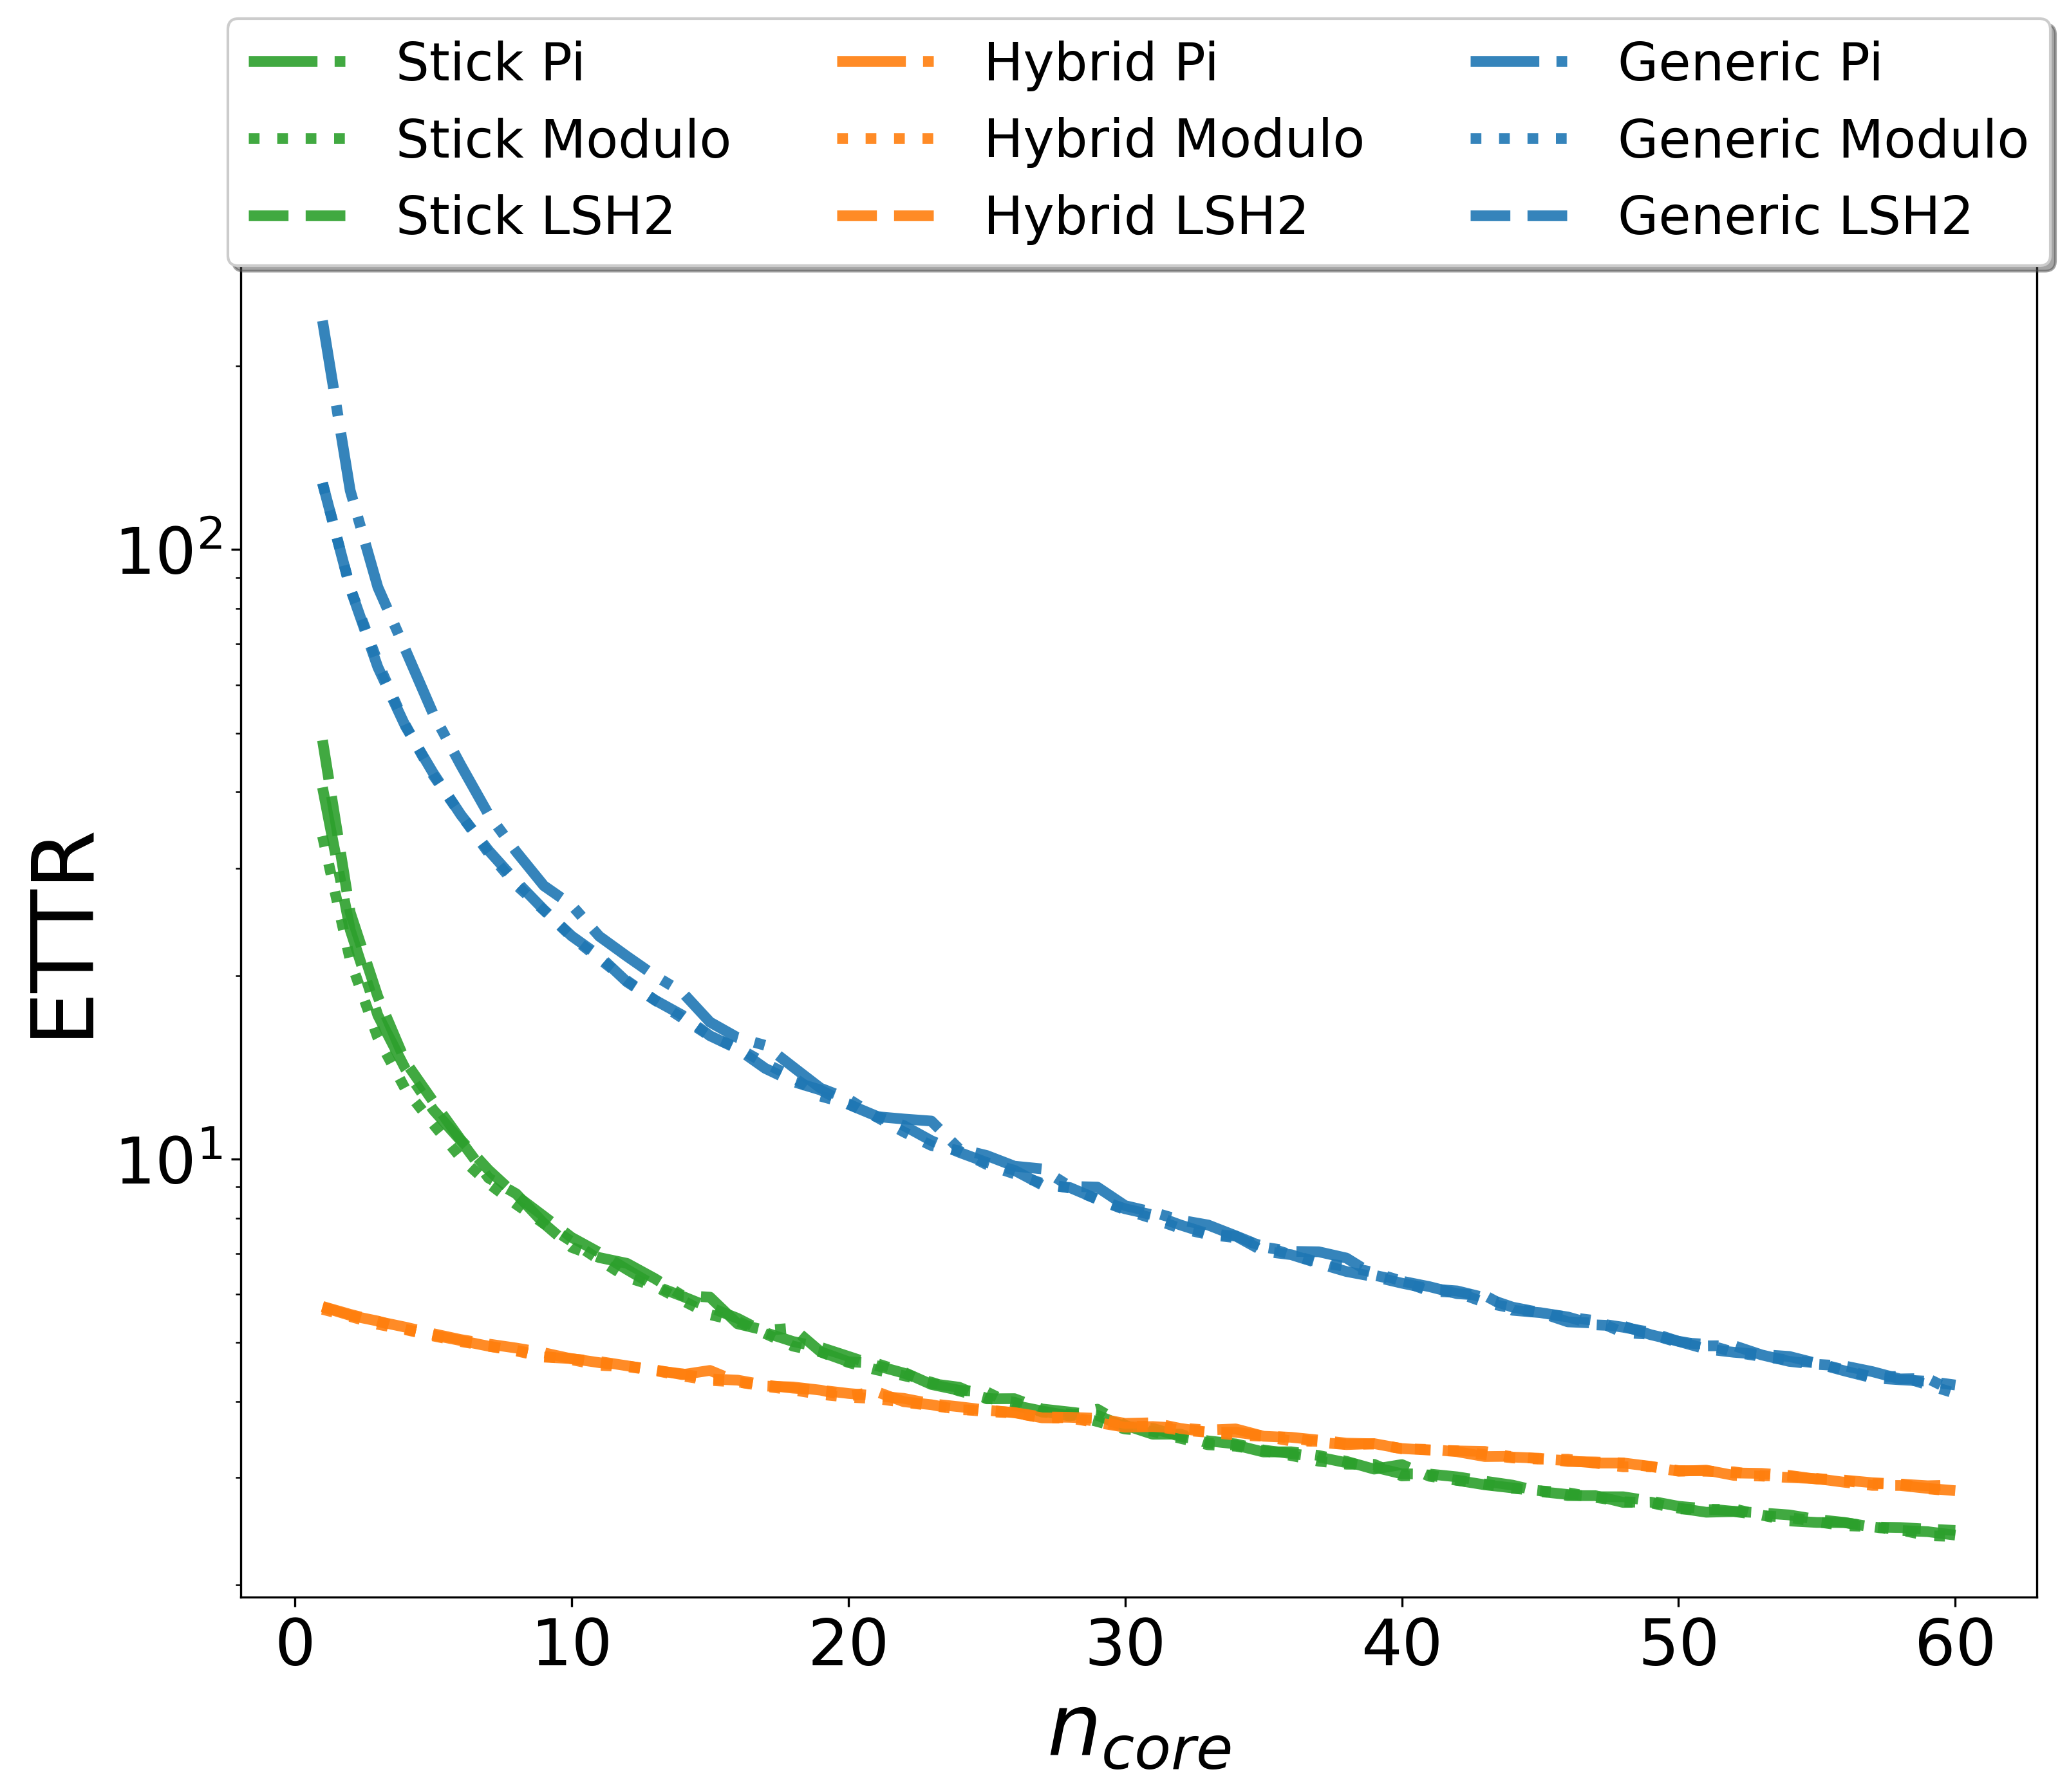
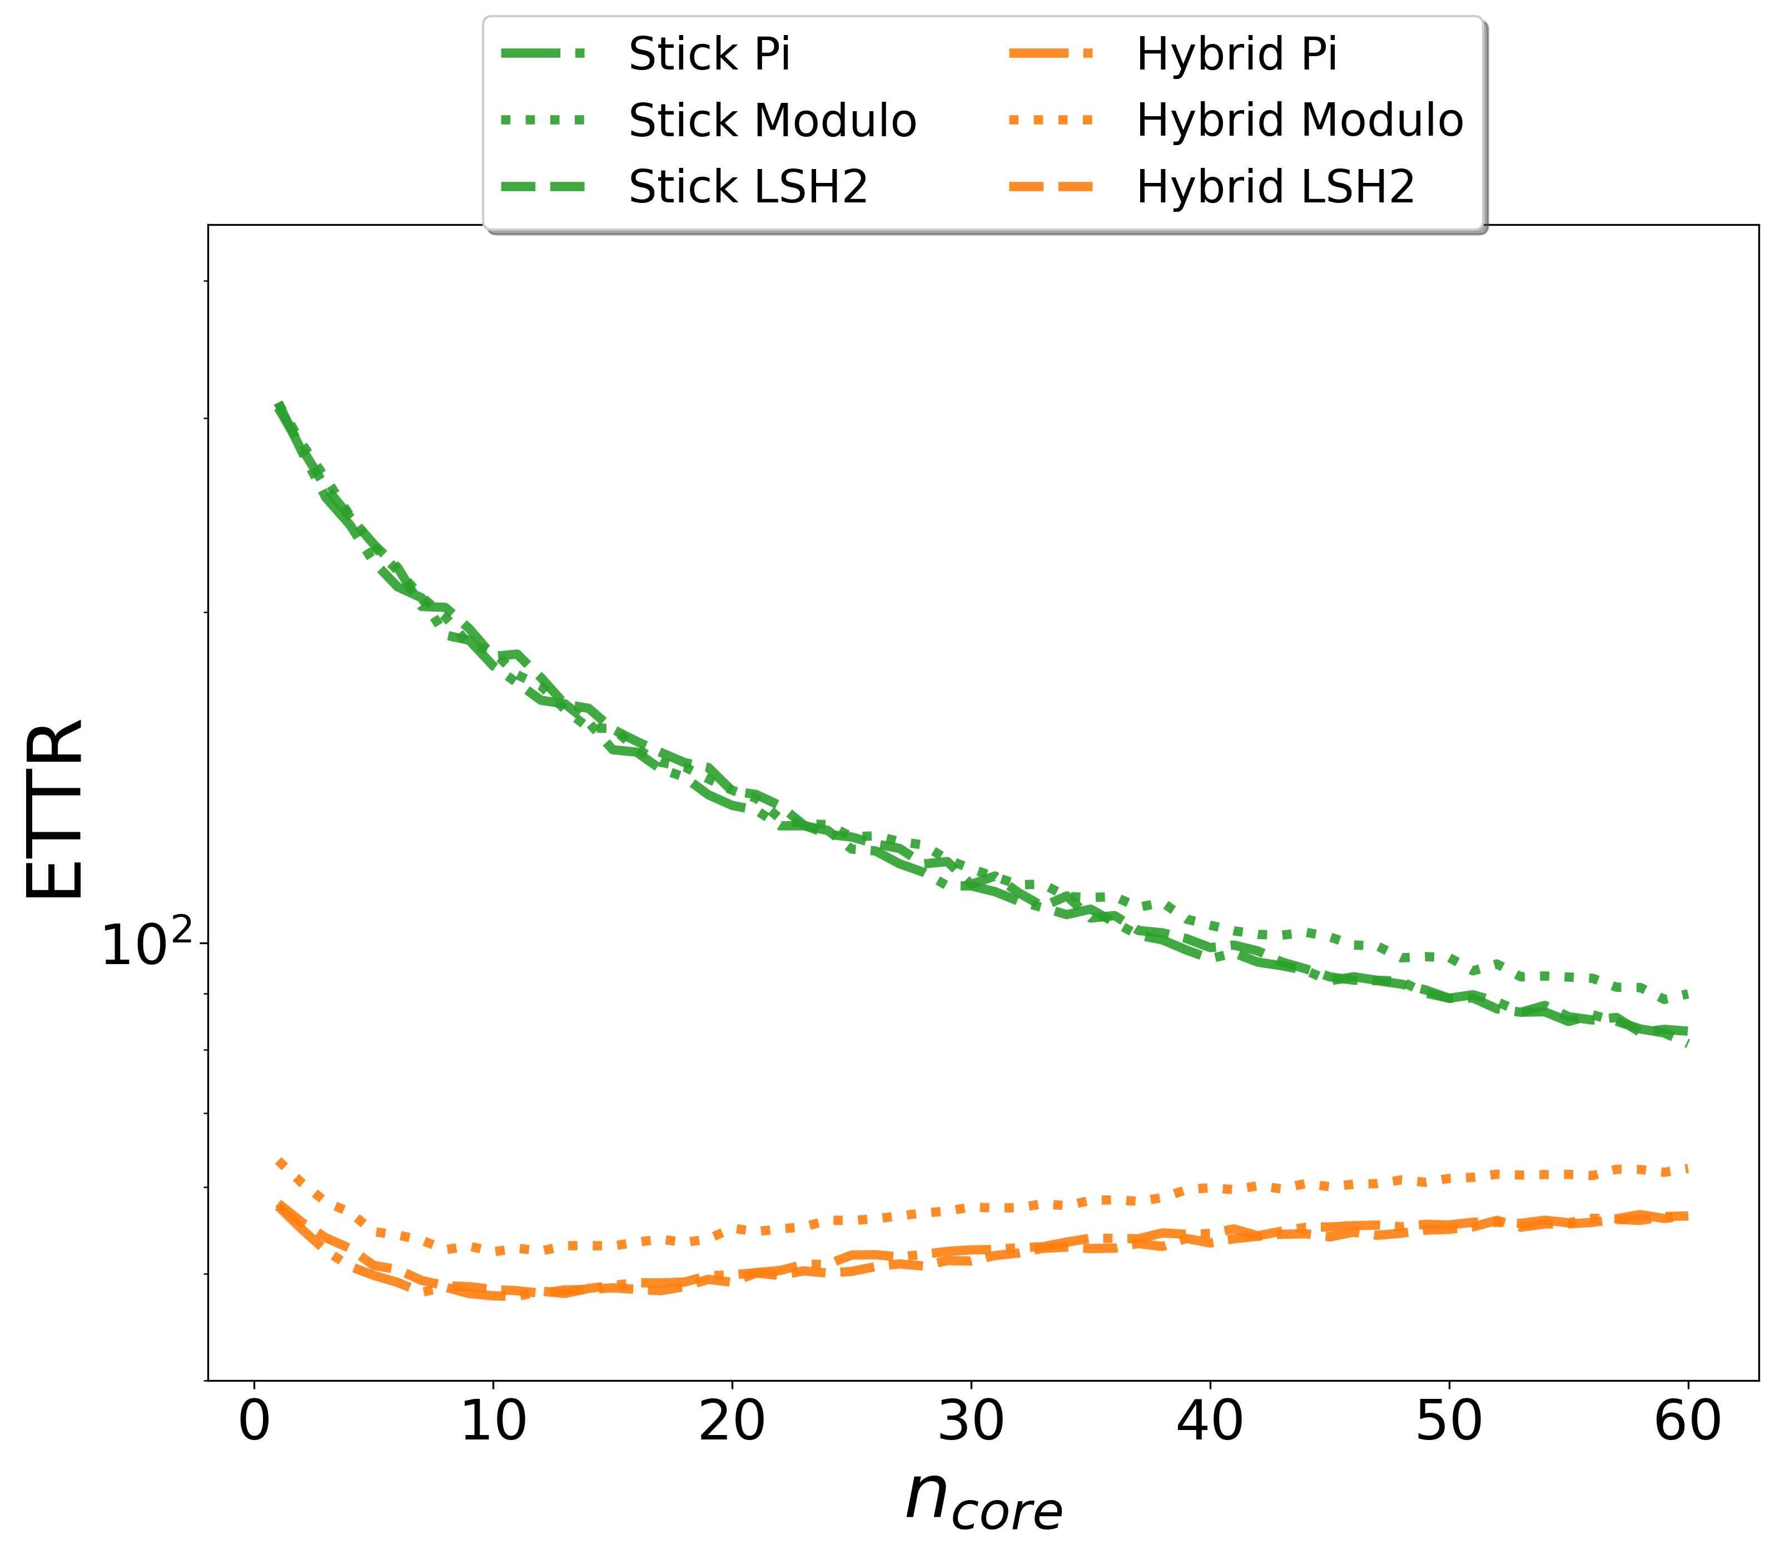
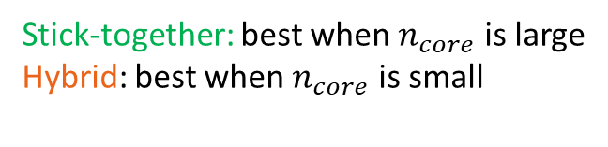
Simulation: 100 users / Sync & Async / ETTR
Synchronous setting
Asynchronous setting
Stick-together: best when $n_{core}$is large
Hybrid: best when $n_{core}$is small
Hybrid performs best
35

Slide 36
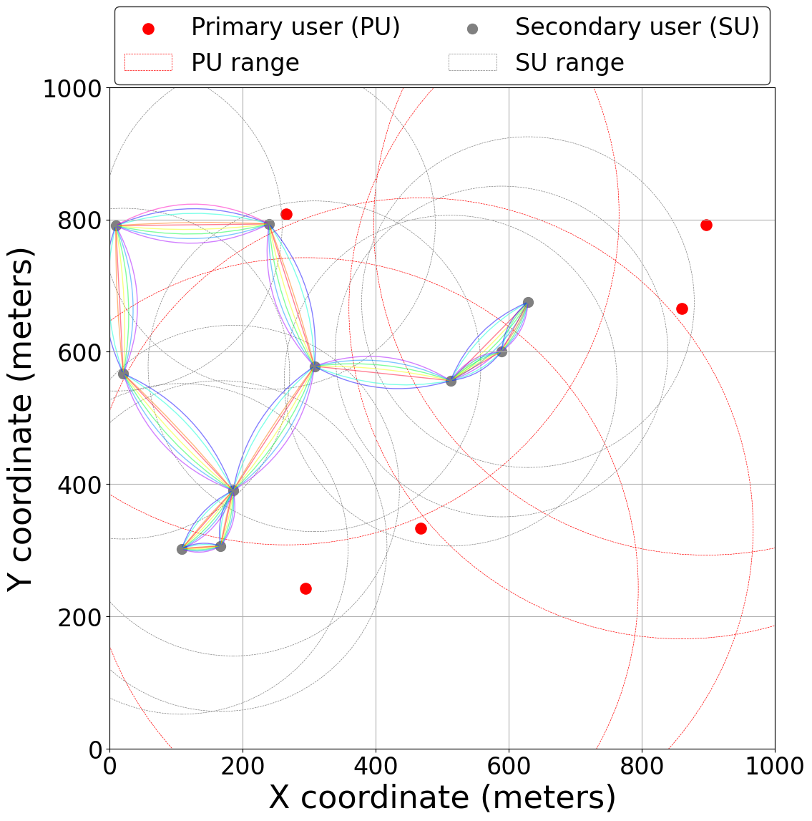
Multichannel Topology Discovery Problem
Extension of the traditional rendezvous framework
Considers network topology Involves both PUs and SUs in geographical area
Network Model
  PUs with communication ranges
  SUs with communication ranges
  Edges indicate proximity and communication capability between SUs

Slide 37
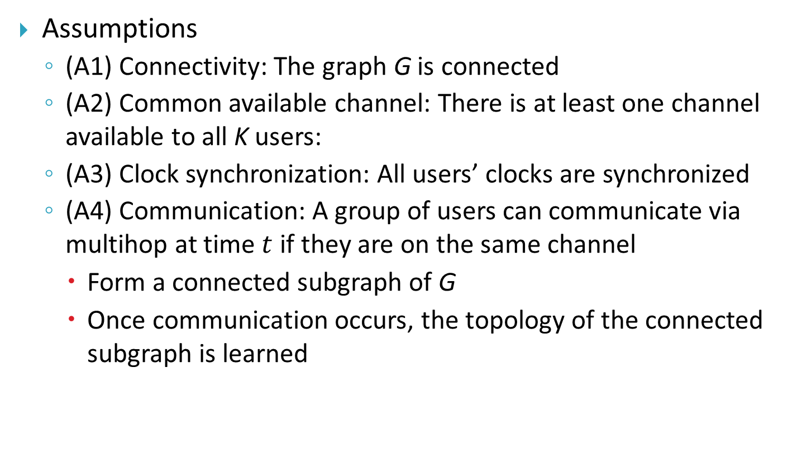
Problem Formulation
Assumptions
  (A1) Connectivity: The graph G is connected
  (A2) Common available channel: There is at least one channel available to all K users:
  (A3) Clock synchronization: All users’ clocks are synchronized
  (A4) Communication: A group of users can communicate via multihop at time $t$ if they are on the same channel
    Form a connected subgraph of G
    Once communication occurs, the topology of the connected subgraph is learned
Too strong
OK if there are satellites
Too strong

Slide 38
Problem Formulation
Initial Knowledge
  Each user initially knows only:
    Its own available channel set
Multichannel Topology Discovery Problem
  All $K$ users must collaboratively learn:
    Adjacency matrix $A$
    The available channel sets $c_{k}$​ for all users $k=1,2,…,K$
Notes:
每個用戶在一開始只知道自己的available channel set。
接著這個問題的目標是：所有 K 個用戶必須合作，學習到兩個關鍵資訊：
第一個是前面提到的Adjacency matrix $A$
第二個是每個用戶的available channel set.

Slide 39
Problem Formulation
Operation in Each Time Slot
  Every user hops to one of its available channels
  Upon meeting others on the same channel, users exchange information
  Each user maintains:
    (i) A list of known users and their available channel sets
    (ii) A list of known edges among known users
  At the start:
    Known user list contains only itself and its channel set
    Known edge list is empty
Notes:
這裡我們說明每個time slot 做些甚麼：
簡單來說，每個用戶都會隨機跳到自己可以用的某個頻道。如果剛好遇到別人在同一個頻道，大家就會交換彼此知道的資訊。
那每個人平常會記錄兩件事：
認識了哪些人，還有他們各自能用哪些頻道。
這些已經認識的人之間有哪些edge 。
一開始，其實每個人只知道自己，還有自己能用哪些頻道，其他都不知道。
然後，大家透過不斷地相遇、交換資訊，慢慢把整個網路的整個toplogy學起來。

Slide 40
Problem Formulation
Information Exchange
  At time t, users hopping onto the same channel $c$ may form one or more connected subgraphs $G_{c}$
  For each connected subgraph
    Users update their known user list to the union of all known user lists in the group
    Users update their known edge list to the union of all known edge lists, plus the edges in $G_{c}$​ itself
  If multiple connected subgraphs exist on the same channel, each updates knowledge independently
Notes:
這邊我們說明user之間怎麼交換資訊。
簡單來說，每個時刻，大家會跳到某個頻道上。如果同時跳到同一個頻道的人夠多，他們可能會形成一個或好幾個connected subgraph。
在每個connected subgraph裡，大家會做兩件事：
第一件事就是把用聯集的方式大家互相分享認識的所有人。
再來就是把大家知道的edge list 也合在一起，而且還要加上這個圈圈裡原本就有的連結。
如果同一個頻道上剛好有好幾個這種connected subgraph，那每個 subgraph就各自交換資訊，不會互相影響。

Slide 41
Problem Formulation
Performance Metrics
  Time-to-discovery (TTD): Number of time slots needed for all users to fully reconstruct the topology and learn all channel sets
  Expected time-to-discovery (ETTD): The average number of time slots required for complete topology discover
  Maximum time-to-discovery (MTTD): The worst-case number of time slots required for complete topology discover
Goal
  Design channel hopping algorithms that minimize TTD, i.e., enable fast and efficient multichannel topology discovery
We expect that the consistent channel hopping algorithms also perform very well for the multichannel topology discovery problem.
Notes:
這邊我們來看怎麼衡量演算法的好壞，以及我們的目標是什麼。
TTD（Time-to-discovery）：就是所有用戶都能完全學到整個topology所需要花的時間。
ETTD（Expected time-to-discovery）：就是TTD的平均。
MTTD（Maximum time-to-discovery）：其實就是TTD的worse case.
當然，我們的目標，就是要設計一個channel hopping algorithms ，讓TTD越小越好，也就是說，希望大家可以又快又有效率地完成multichannel topology discovery

